Slide 1
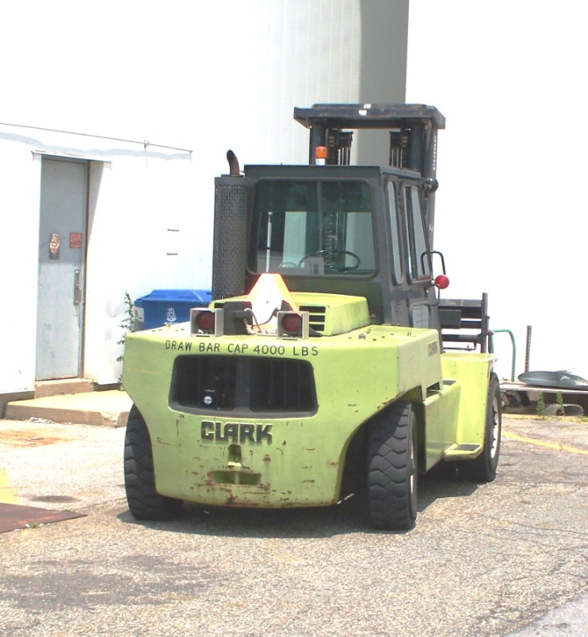
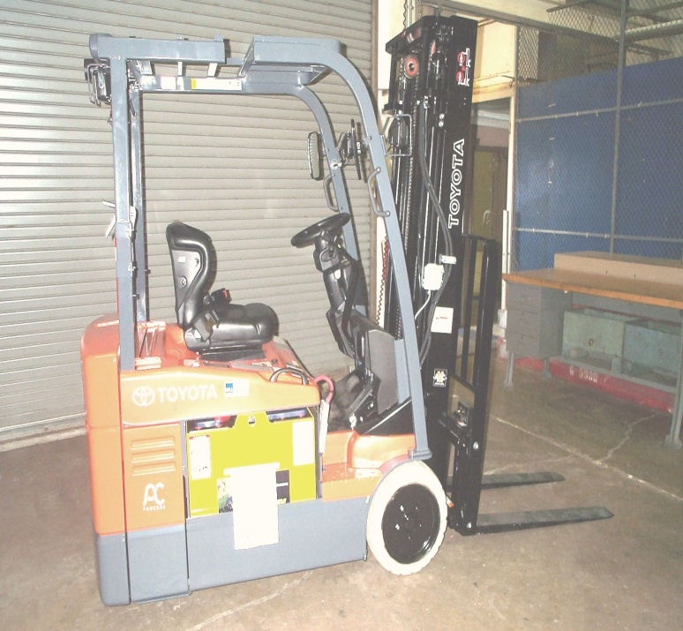
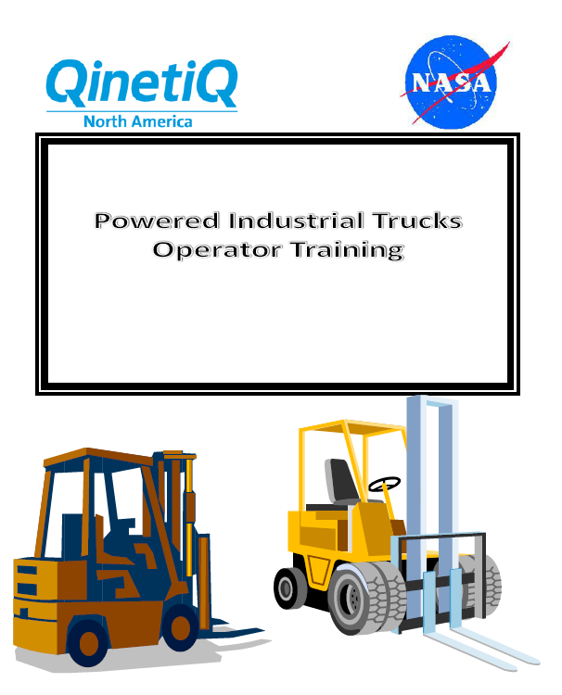
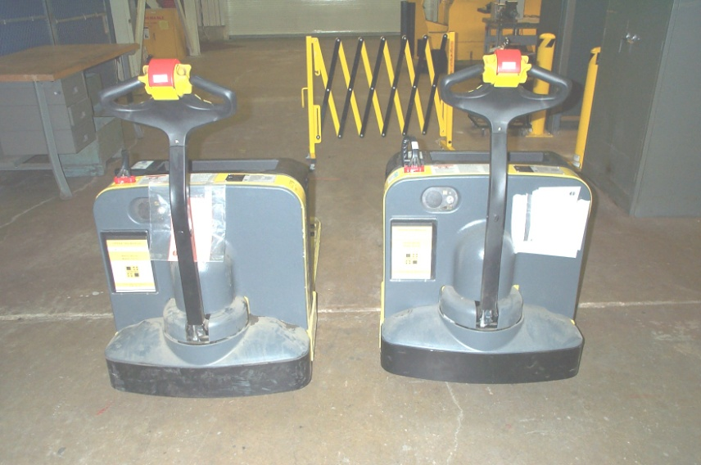
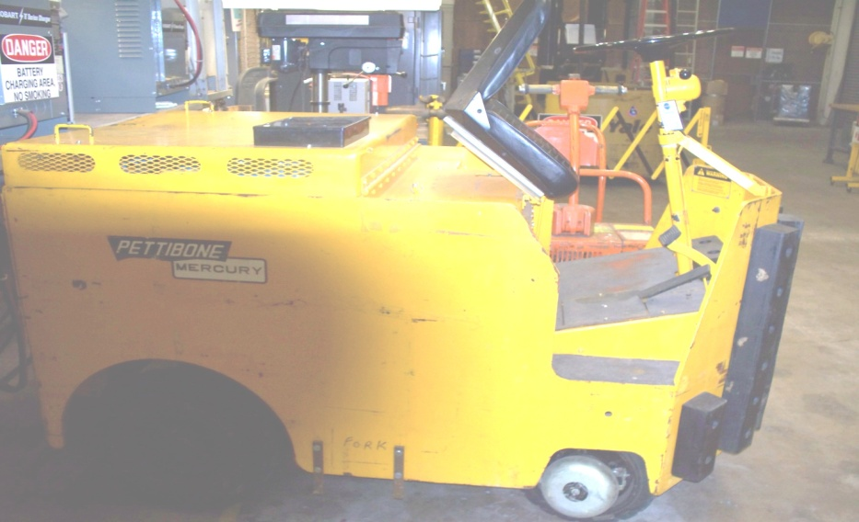
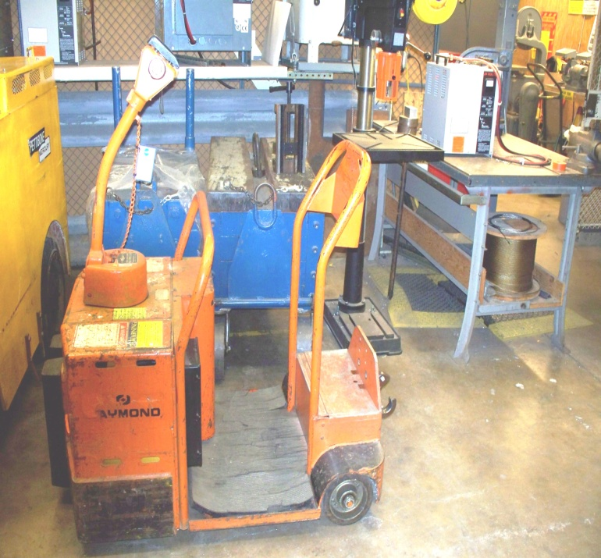
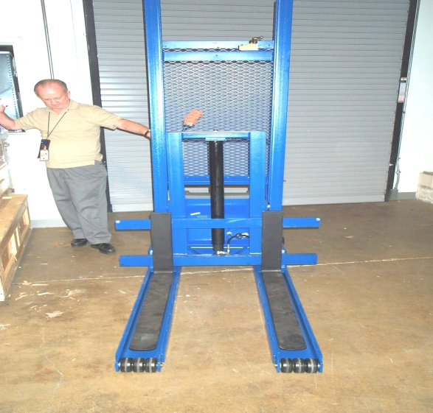
PIT
Instructor: Joe Selba

Slide 2
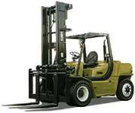
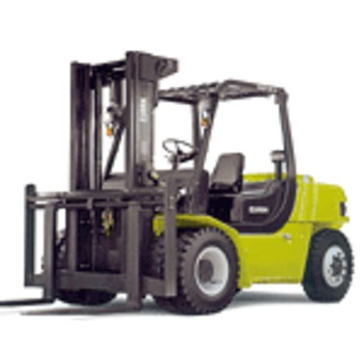
AGENDA
Introductions
Course Objectives
Common Powered Industrial Truck Terminology
NASA-STD-8719.9
And the Relationship to:
  OSHA 1910.178
  ANSI/ITSDF B56.1-2009
  ANSI/ITSDF B56.1-2005
GPR 8719.1A
GPR 8834.1B
Pre-operational Inspection
Forklift Accidents And Fatalities
Video - Forklift Maneuvers (All The Right Moves
Written Test
Hand-On Test

Slide 3
Introductions
Who Are You?
Why are attending this Training?
What type of Powered Industrial Trucks will you be operating?
Do you have any prior experience operating Powered Industrial Trucks?

Slide 4
Course Objectives

Slide 5
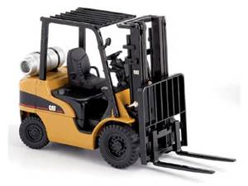
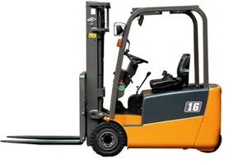
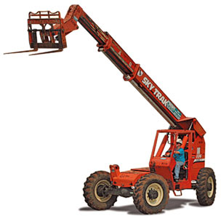
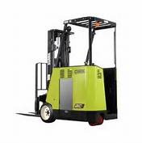
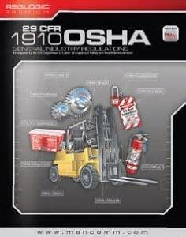
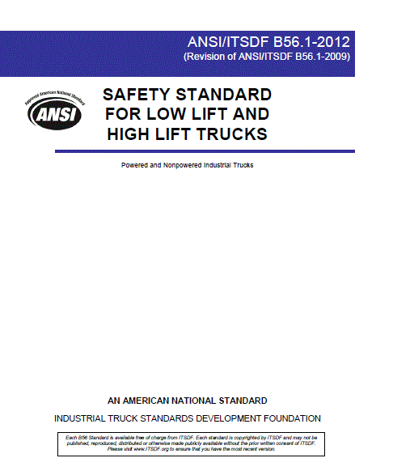
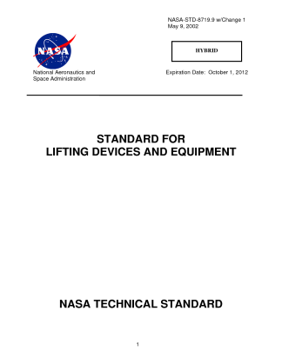
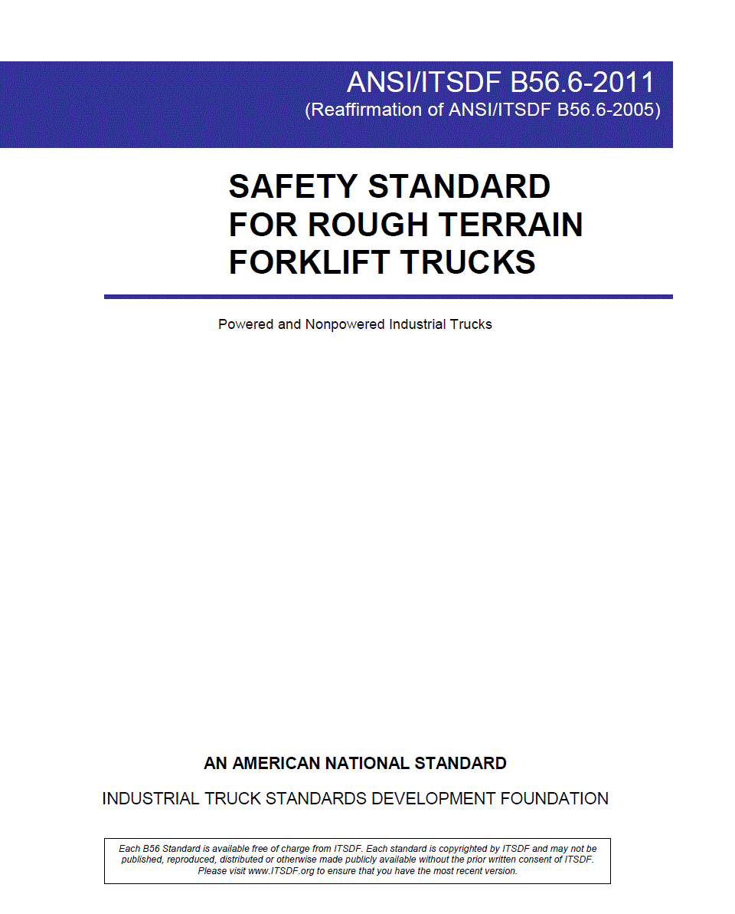
Course Objectives
Given any selected Powered Industrial Truck (Forklift), you should be able to perform an operational check of the Unit without error.
Given the basic requirements for a lift, you will be able to plan the lift such that it can be accomplished efficiently, safely, and in complete accordance with OSHA 1910.178, ANSI B56.1 ANSI B56.6, GPR8834.1, GPR8719.1, and NASA-STD-8719.9.

Slide 6
Course Objectives
Upon completion of the course participants will be able to:
Understand and comply with NASA-STD – 8719.9
Understand and comply with ANSI/ASME Standard/ITSDF B56.1
Understand and comply with ANSI/ASME Standard/ITSDF B56.6
Understand and comply with OSHA 1910.178
Complete a written exam to demonstrate understanding of Codes and Standards as well as operation and inspection requirements.
Complete a Hands-On operational exam to demonstrate skill and ability to operate a Powered Industrial Truck in a practical setting.

Slide 7
Course Objectives
Upon completion of the course participants will be able to:
Operate a forklift truck safely, reducing the risk of injury to operators and pedestrians.
__________________________________________________________________________________________________________
Develop safe operating habits.
______________________________________________________________________________________________________________________________
Explain the differences between a Forklift and a Car.
__________________________________________________________________________________________________________________________
Explain the consequences of operating a Powered Industrial Truck unsafely.
___________________________________________________________________________________________________________________________
Explain the proper procedure to load and unload safely.
___________________________________________________________________________________________________________________________
Refuel/Recharge forklift trucks safely
___________________________________________________________________________________________________________________________
Explain and perform methods to Handle awkward loads

Slide 8


Common
Powered Industrial Truck
Terminology

Slide 9
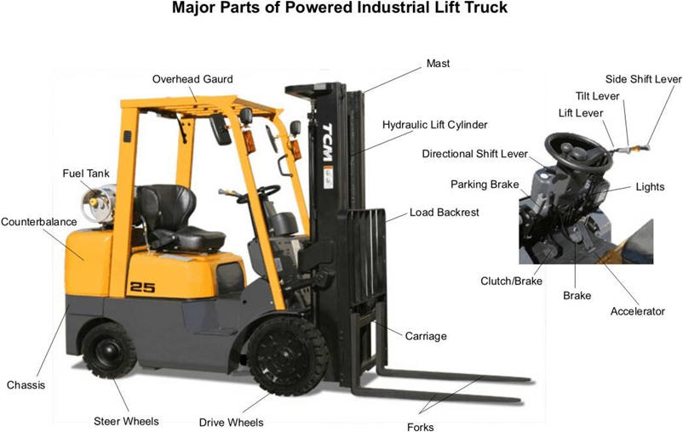
Lets see what we already know!!!

Slide 10
Forklift Terminology
Overhead Guard

Slide 11
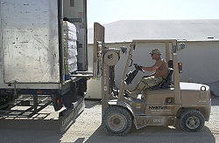
Forklift Truck
Forklift Terminology
A Forklift
(also called a lift truck, a high/low, a stacker-truck, trailer loader, side loader, fork truck, tow-motor or a fork hoist) is a powered industrial truck used to lift and transport materials. The modern forklift was developed in the 1920s by various companies including the transmission manufacturing company Clark and the hoist company Yale & Towne Manufacturing.
The forklift has since become an indispensable piece of equipment in manufacturing and warehousing operations.

Slide 12
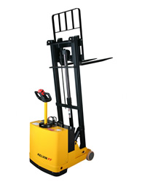
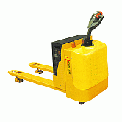
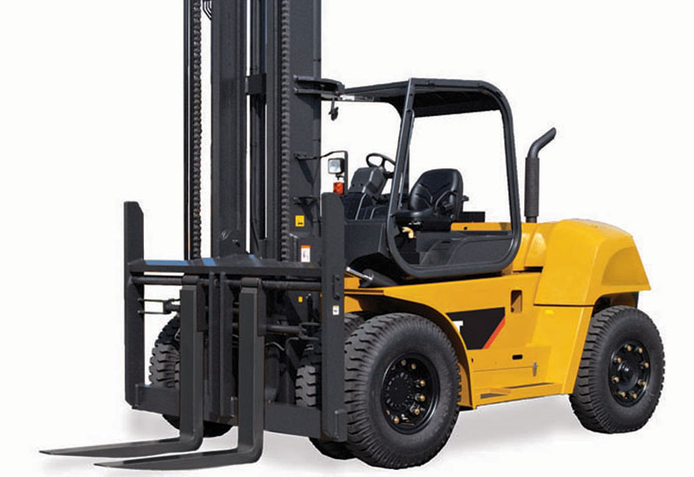
Forklift Terminology
Fork Lift Types
Industrial Lift Trucks
There are two Primary types of industrial lift trucks:
High Lift and Low Lift
They are designed to operate primarily on finished surfaces in an industrial environment.

Slide 13
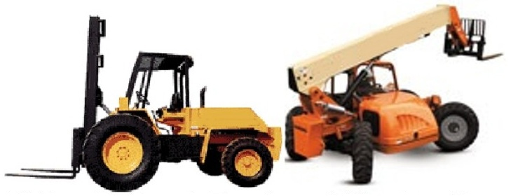
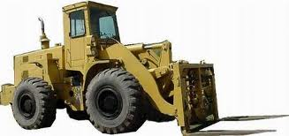
Forklift Terminology
Fork Lift Types
Rough Terrain Lift Trucks
There are two types of rough terrain lift trucks: Vertical Mast and Telescoping Boom
They are designed to operate on unimproved surfaces such at construction sites.

Slide 14
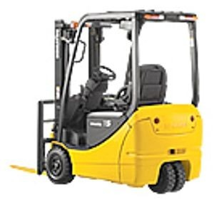
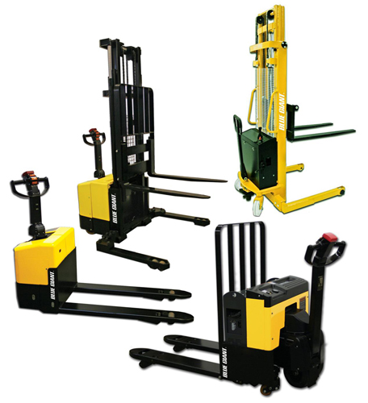
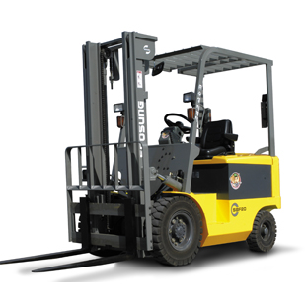
Forklift Terminology
Fork Lift Types
High Lift Trucks are primarily designed to stack and move loads. They may have three or four wheels and have no suspension other than tires.
Their capacities can exceed 100,000 lbs., but more commonly range from 2,000 to 10,000 lbs.
High Lift Industrial
Lift Trucks
Walk-Behind/ Stacker
3-Wheel
Sit-Down Rider
4 Wheel
Sit-Down Rider

Slide 15
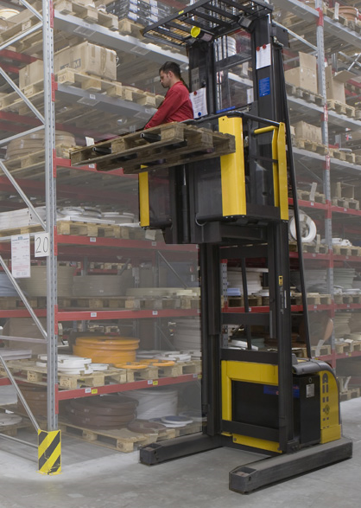
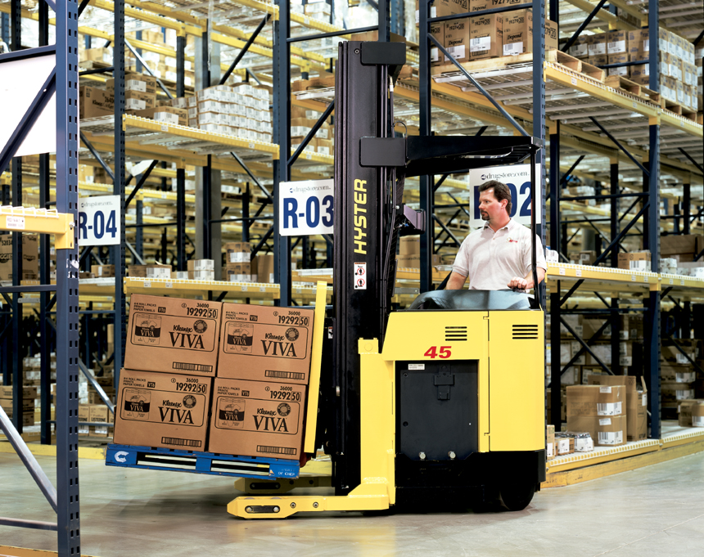
Forklift Terminology
Fork Lift Types
Operator-Up trucks enable narrow aisle operation and elevation of the operator station. Out riggers can straddle loads or be positioned under shelves when placing loads.
High Lift
(Order Picker and Stand-up Narrow Aisle Reach Truck)

Slide 16
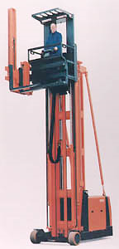
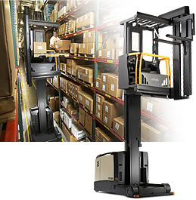
Forklift Terminology
Fork Lift Types
Operator-Up Turret Truck
Operator lifted with the load to allow precise stacking and picking.
5-7 ft. minimum aisle width is required

Slide 17
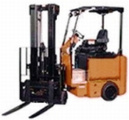
Forklift Terminology
Fork Lift Types
Operator-Down Turret Truck
Operator is not lifted with the load
These forklifts are termed a swingmast truck (picture shown) when, instead of just the forks, the entire mast rotates.
5-6 ft. minimum aisle width is required.
Swing Mast Rider Electric/I/C (Internal Combustion Engine)

Slide 18
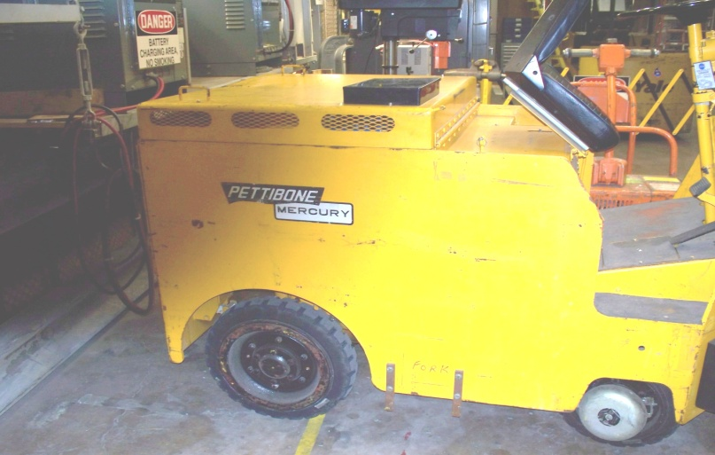
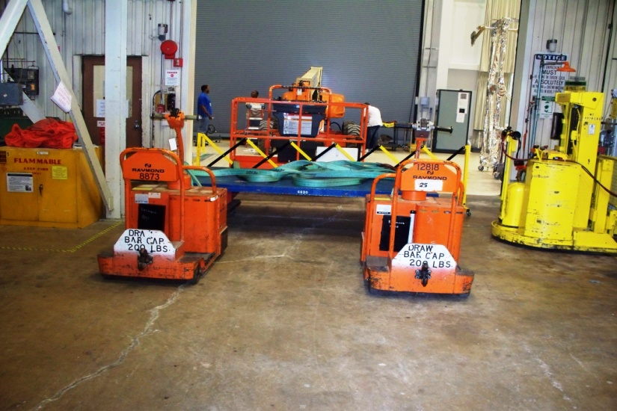

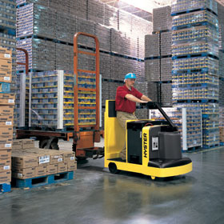
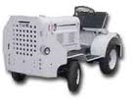
Forklift Terminology
Powered Tugs and
Tow Tractors
Electric and
I/C (Internal Combustion Engine)

Slide 19
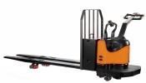
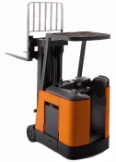
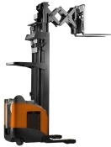
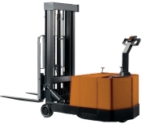
Forklift Terminology
Fork Lift Types
Low Lift Walkie/Rider Pallet Truck Electric
Stand-Up 3-Wheel
Truck Electric
Reach Truck
Counter-Balanced Stacker Truck Electric

Slide 20
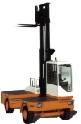
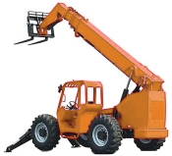
Forklift Terminology
Fork Lift Types
Side Loader - Electric/IC
Telescopic Rough Terrain Truck - IC

Slide 21
Forklift Terminology
Generally we use the Sit down Rider and Walk behind Stacker type and this will be our main focus.

Slide 22
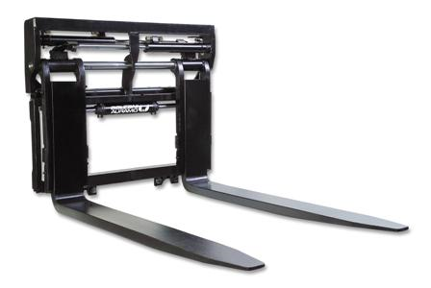
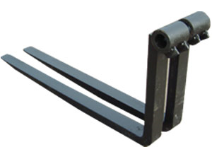
Forklift Terminology
Forks
Forks come in two styles, hook type and pin type. Hook type are generally found on trucks up to 14,000 lbs. capacity. Pin, or shaft mounted, type forks are found on the larger capacity lift trucks.

Slide 23
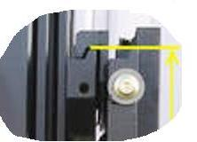
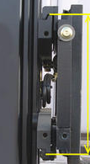
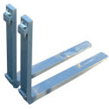
Forklift Terminology
Forks
Hook type forks are so named as they hook over and lock into the bars of the fork carriage. The forks can be adjusted by sliding the upper and lower hooks along the carriage bars.

Slide 24
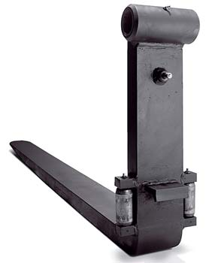
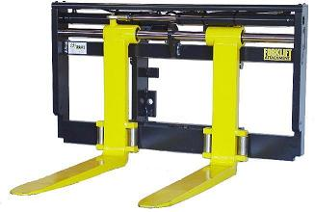
Forklift Terminology
Forks
Pin type forks mount to the fork lift carriage by means of the fork pin or shaft. The pin slides through an eye on the top of the fork and holds the fork to the fork carriage.

Slide 25
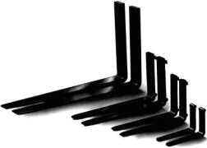
Forklift Terminology
Forks
Forks sizes have been standardized within the industry and are load rated according to fork thickness and width. The fork rating will be stamped on the shank of the fork.

Slide 26


Forklift Terminology
Fork Carriages
Carriages have been standardized for hook type fork carriages. There are four sizes of hook type fork carriages rated by lifting capacity of the fork carriage.
Class I carriages are rated for loads up to 2000 lbs. The carriage bar spacing is 13 inches.
Class II carriages are rated for loads up to 5,550 lbs. The carriage bar spacing is 16 inches.
Class III carriages are rated for loads up to 10,000 lbs. The carriage bar spacing is 20 inches.
Class IV carriages are rated for loads up to 15,500 lbs. The carriage bar spacing is 25 inches.
Carriages for Pin Type Forks will vary from manufacturer to manufacturer. Capacity of the carriage will be determined by the fork size and the carriage pin size. Pin mounted forks will also vary by the amount of offset between the fork and the fork eye.

Slide 27



Forklift Terminology
Sideshift
Sideshift is the movement of the forks side to side. This is to assist in positioning the forks when picking up or depositing a load. Sideshift is normally used to insure the load is correctly centered on the forks without having to reposition the forklift.
Sideshift carriages are available on most forklift trucks and can be either “integral”, meaning they are part of the original equipment fork carriage, or “hang-on”, meaning they can be added later and mount on the original equipment fork carriage.

Slide 28





Forklift Terminology
Attachments
The use of any attachments Require Forklift Manufacturers approval and must be added to Capacity tag by Manufacturer Stating Type / Capacity and Load Centers with and without attachments.

Slide 29






Optional Types of Attachments
Carpet Pole, Fork Mounted
Carton Clamp
Paper Roll Clamp
Fork Extensions
Push/Pull
Barrel Handler

Slide 30



Forklift Terminology
Batteries & Chargers
Electric forklifts use industrial traction batteries. Forklifts in the USA will usually be equipped with batteries in the following voltages – 12v, 24v, 36v, and 48v. There are some forklifts being produced that use 72/80v batteries.

Slide 31



Forklift Terminology
Batteries & Chargers
Electric forklift batteries are available in two general types: Flooded or Sealed.
A flooded battery is one where water must be added regularly to maintain the electrolyte level in the battery.
A sealed battery (also called “maintenance free” ) does not require the addition of water. Sealed batteries use a chemical reaction to maintain proper fluid level over the life of the battery.

Slide 32

Forklift Terminology
In some electric forklifts, the battery is used as the truck counterweight.
The forklift lifting capacity is based on the battery being a specified minimum weight.
The battery minimum weight will be listed on the truck nameplate along with the maximum amp-hour capacity of the battery.

Slide 33


Forklift Terminology
Battery chargers must be matched to the battery being charged. Always insure the charger is the same voltage as the battery being charged and that the charger has sufficient amp-hour capacity to charge the battery. Always insure the battery is connected to the charger before starting the charging cycle. Check the battery nameplate attached to the battery for information on the battery voltage, amp-hour capacity, and battery weight.

Slide 34

Forklift Terminology
For best battery life
Always keep the battery clean, and for flooded batteries, insure fluid levels are maintained.
As a general rule, charge the battery and let the battery rest for a period before use.
Do not discharge the battery below 80% of battery amp-hour capacity before recharging. Pay close attention to the battery level gauge and never operate below 20% remaining charge.
Use an “equalizing” charge every fifth charge to insure all cells are maintained at the same voltage.

Slide 35
Forklift Terminology
Fork Lift trucks may be specifically labeled as to their acceptability for use in hazardous locations. A labeled truck indicates the design has met the minimum standards for this type of lift truck.
ANSI/UL 558 for Engine Powered Trucks
ANSI/UL 583 for Electric Trucks
Reference: ANSI/ITSDF B56.1-2009 4.19.4 (16) (b) (5)
Reference: ANSI/ITSDF B56..6-2005 5.6.2.1

Slide 36

Forklift Terminology
Electric Trucks
Type “E” trucks meet the minimum standards for fire and electrical hazards. This is the most common designation for electric trucks.
Trucks labeled type E cannot be used in hazardous locations.
Type “ES” trucks meet all the requirements of Type “E” trucks and have additional equipment to prevent the emission of sparks and limit the surface temperature of lift truck components.
Type “ES” trucks are not commonly found in the marketplace.
Type “EE” trucks meet all the requirements of Type “E” and “ES” trucks and also have all electrical motors and spark producing electrical components completely enclosed.
Type “EE” trucks are generally used where a hazardous environment has been identified.
Type “EX” trucks are specially designed for use in atmospheres where flammable vapors, fibers or dust may be present.
These trucks are constructed using no spark producing components along with other protective measures.
Fire and Electrical Hazard Labeling
Reference: ANSI/ITSDF B56..6-2005 5.6.2.2
Reference: ANSI/ITSDF B56.1-2009 4.19.4 (16) (b) (5)
Reference OSHA Standard 29CFR 1910.178 (b) (1-12)

Slide 37
Forklift Terminology
Fire and Electrical Hazard Labeling
IC Engine Powered Trucks
IC engine powered trucks are labeled according to the fuel used to power the lift truck.
Type “G” trucks are gasoline fueled and meet the minimum standards for fire hazards.
This is the most common designation found on gasoline fueled lift trucks
Trucks labeled “G” are not used in hazardous locations.
Type “GS” trucks are gasoline fueled and meet all requirements of a Type “G” truck and have other equipment installed to the electrical system, fuel system, and exhaust system to allow them to be used in certain hazardous applications.
Type “GS” trucks are used in similar applications to Type “EE” electric trucks.
Reference: ANSI/ITSDF B56..6-2005 5.6.2.2
Reference OSHA Standard 29CFR 1910.178 (b) (1-12)
Reference: ANSI/ITSDF B56.1-2009 4.19.4 (16) (b) (5)

Slide 38
Forklift Terminology
Fire and Electrical Hazard Labeling
IC Engine Powered Trucks
Type “LP” trucks are LPG fueled and meet the minimum standard for fire hazards. This is the most common designation found on LPG fueled lift trucks.
Trucks labeled “LP” are not used in hazardous locations.
Type “LPS” trucks are LPG fueled and meet all requirements of a Type “G” truck and have other equipment installed to the electrical system, fuel system, and exhaust system to allow them to be used in certain hazardous applications.
Type “LPS” trucks are used in similar applications to Type “GS” and Type “EE” electric trucks.
Type “G/LP” trucks are duel fuel units as they may be operated on gasoline or LPG without any alteration to the fuel system. Trucks labeled “G/LP” meet the minimum standards for fire hazards.
Trucks labeled “G/LP” are not used in hazardous locations.
Type “GS/LPS” trucks are duel fuel units as they may be operated on gasoline or LPG without any alteration to the fuel system. These trucks meet all requirements of a Type “GS” or Type “LPS” truck and have other equipment installed to the electrical system, fuel system, and exhaust system to allow them to be used in certain hazardous applications.
Type “GS/LPS” trucks are used in similar applications to Type “GS”, Type “LPS” and Type “EE” electric trucks.
Reference: ANSI/ITSDF B56..6-2005 5.6.2.2
Reference OSHA Standard 29CFR 1910.178 (b) (1-12)
Reference: ANSI/ITSDF B56.1-2009 4.19.4 (16) (b) (5)

Slide 39
Forklift Terminology
Fire and Electrical Hazard Labeling
IC Engine Powered Trucks (Continued)
Type “D” trucks are diesel fueled and meet the minimum standards for fire hazards.
Trucks labeled “D” are not used in hazardous locations.
Type “DS” trucks are diesel fueled and meet all requirements of a Type “D” truck and have other equipment installed to the electrical system, fuel system, and exhaust system to allow them to be used in certain hazardous locations
Type “DS” trucks are used in similar applications to Type “GS”, Type “LPS” and Type “EE” electric trucks.
Type “DY” trucks are diesel fueled and meet all the requirements of Type “DS” trucks and in addition do not have any electrical equipment installed.
These use air starters and have provisions for limiting the temperature of truck components.
These type trucks are used in similar application to the Type “EE” electric trucks.
Reference: ANSI/ITSDF B56..6-2005 5.6.2.2
Reference OSHA Standard 29CFR 1910.178 (b) (1-12)
Reference: ANSI/ITSDF B56.1-2009 4.19.4 (16) (b) (5)

Slide 40



Forklift Terminology
Tires
Cushion – Smooth profile, solid tire. The tread is bonded to a steel ring to form the tire. The tire is pressed on to a hub that is mounted to the lift truck. Normally used in smooth floor warehouse applications.

Slide 41




Forklift Terminology
Tires
Pneumatic
Various tread patterns, filled with air. Mounted to multi-piece rims.
Normally used in outdoor, rough surface applications.
May be foam filled for puncture resistance.

Slide 42

Forklift Terminology
Solid Pneumatic / Pneumatic Shaped Solid
Tires
Solid tire molded in the shape of a pneumatic tire.
Has a soft rubber inner core to provide the ride of a pneumatic tire while providing the puncture resistance of a solid tire.
Normally used in all types of applications to replace pneumatic tires.

Slide 43


Forklift Terminology
Transmissions
Manual
Manually shifted transmission.
Lift truck is equipped with a clutch.

Slide 44

Forklift Terminology
Transmissions
Powershift
One, two, or three speed depending on the size of the lift truck.
Trucks up to 6,000 lbs capacity normally use a single speed transmission.
Trucks from 7,000 to 15,000 lb. capacity normally use a two speed transmission.
Trucks above 16,000 lbs capacity normally use a three speed transmission.

Slide 45


Forklift Terminology
Transmissions
Hydrostatic
Hydraulic drive. A hydraulic pump is driven by the lift truck engine in place of a transmission.
Hydraulic power from the pump is supplied to hydraulic drive motors attached to the drive wheels to power the lift truck.
Drive
Wheel

Slide 46

Forklift Terminology
Direction Controls
Column Mounted direction control (forward /reverse) is mounted on the steering column.

Slide 47

Forklift Terminology
Direction Controls
Foot Operated – direction control (Forward/Reverse) is controlled by shifting accelerator pedal side to side. Allows the Operator to change directions without removing hands from the steering wheel.

Slide 48




Forklift Terminology
There are as many designs for controls as there are manufacturers and years of production from each manufacturer. Although many are similar you must familiarize yourself with the equipment you are about to operate.

Slide 49






Forklift Terminology

Slide 50



Forklift Terminology
Back-Up Alarms
ANSI/ITSDF B56.1-2009 Sec. 4.15.2 states:
The user SHALL determine if operating conditions require the truck to be equipped with additional sound – producing or visual (such as lights or blinkers) devices, and be responsible for providing and maintaining such devices.

Slide 51


Car Versus A Lift Truck
VS.

Slide 52

Steering Systems
Automobile Front Steering 0º - 55º
Lift Truck Rear Steering 0º - 90º
Remember,
Provide Adequate Clearance

Slide 53


Points Of Suspension
Automobile – 4 point suspension
Shocks, Springs, Leaf Springs
Lift Truck – 3 point suspension
TIRES?

Slide 54



Center Of Gravity
An Automobiles CG IS Constant.
A Lift Trucks CG Is Variable depending on load, center of load and condition of surface.
No Load On Forks

Slide 55



Operating Surfaces
Automobile – Prepared Surfaces
Lift Truck –Prepared & Rough Terrain Surfaces

Slide 56

Keep Your Distance!!!
1
2
3
Maintain at least three truck lengths distance between yourself and any truck ahead. Truck lengths includes the truck, forks, and loads.

Slide 57


Stability Triangle
Center of Gravity
Stability Triangle Shown On An Electric Stand-Up Lift Truck
Remember The Center Of Gravity Is Always Changing
No Load
With Load

Slide 58


Fulcrum Point
The fulcrum point (pivot point) is the point of rest on which a lever turns. On a sit down lift truck the fulcrum point is the middle of the drive wheel hub.

Slide 59


Load Center
A 24 Inch Load Center
Majority of lift trucks have a 24 inch load center. That also means the longest fork that can be used on that truck is a 48 inch. Remember to keep the forks spaced as wide as possible for even weight distribution.

Slide 60

Data Plate Information
Operators Know Your Truck
Truck Model Number
Truck Serial Number
Attachment Information
Maximum Lifting Capacity
Maximum Lifting Height
Trucks Physical Weight
Trucks Load Center Rating
Data Plate Location

Slide 61


Operating On Ramps Or Inclines
When using pallet trucks, always keep forks downgrade and in the raised position when working on a grade
Remember never turn on ramps or inclines, straight up and straight down.

Slide 62
Grade Percentages % ???
All Lift Trucks Have A Maximum Grade Percentage That They Can Travel On, Refer To The Manufacturers Guidelines.
50 Feet
5 Feet
5 Feet
50 Feet
= 5 Divided By 50 = 10%
Outside Ramp Example
1 Foot
8 Feet
1 Foot
8 Feet
= 1 Divided By 8 = 12.5%
Dock Leveler Example

Slide 63



Read The Operators Manuals
Operators Manual Is Suppose To Stay With The Truck At All Times

Slide 64



Buckle-Up Your Seat Belt
If your truck is equipped with a seat belt, make sure you fasten it and pull it snug before operating your truck.

Slide 65

Operators Read All WARNING Labels
Each Warning Label On Your Truck Is Important. Read and obey all of them to protect yourself and your co-workers

Slide 66


HAZARDS
Of Dock Operations!
Trailer Restraint
Must use trailer restraint systems or wheel chocks.
If tractors are not attached, make sure that the landing gear is secure
Travel slowly on dock boards or bridge plates
Avoid getting wheels too close to edge of the dock
Use lights to improve visibility
OSHA stipulates, “Brakes shall be set and wheel blocks shall be in place to prevent movement of trucks, trailers, or rail cars while loading or unloading.”

Slide 67





Arms & Legs
Always keep your arms and legs inside the confines of the lift truck during operation!!

Slide 68


Forklift Operation
FORKLIFT
PARKING

Slide 69

Forklift Operation
Safety Features
Some Forklifts have a tilt up seat that actuates a switch when lowered allowing the controls to be activated.
With no one on the seat, the controls remain inoperable.
This does not substitute setting the park brake when you exit the forklift
Tilt-Up Seat

Slide 70
Safe Handling Of Fuels
Forklift Operation
What Powers These Lift Trucks????
Gasoline
Diesel Fuel
LPG
CNG
Electric (Storage Battery)
Read And Follow All Warnings And Safety Guidelines When Handling Any IC Fuels Or Industrial Batteries.

Slide 71


LPG Fuel
-LPG stands for liquefied petroleum gas
-It is refined from crude oil
-Is extremely flammable
-When in vapor form, it is heavier than air

Slide 72


LPG Fuel Tanks
LPG storage tanks are either steel or aluminum construction
Different size tanks 20, 33.5, or 43.5 lb.
Aluminum Tank
Steel Tank
NOTE: Remember to always use proper lifting techniques

Slide 73


Storage Tank External Parts
Pressure Relief Valve
80% Fill Valve
Liquid Discharge Port
Vapor Discharge Port
Quick Fill Port
Fuel Gauge

Slide 74

Be Aware Of Carbon Monoxide
Carbon monoxide (CO) is a colorless, tasteless, and odorless gas.
Causes headache, drowsiness, and nausea. When these symptoms are disregarded, unconsciousness and death may result.
Any fossil fuel when burned can create CO
CO results from incomplete combustion of fossil fuels
Carbon monoxide is slightly lighter than air, but during hot humid weather, when there is little or no movement of air, CO may not rise.

Slide 75






Battery Hazards
The FOUR main hazards introduced by the use of lead-acid batteries are:
1. Electrolyte (Sulfuric Acid)
2. Hydrogen Gases (Explosive Fumes especially when Charging or Discharging)
3. Electricity (Direct Current Shock Hazards)
4. Battery Weight
(Large forklift Batteries can weigh between 2,200lbs to over 3,000lbs. )

Slide 76


Sulfuric Acid
Sulfuric acid is a strong oxidizing agent that demands extreme care in handling. Small amounts can cause severe burns on skin. All contact should be avoided. Even though the acid is mixed with water to make electrolyte, small amounts of the mixture will destroy fabric and burn your skin.

Slide 77

Batteries Create HYDROGEN GAS
Which isExtremely Explosive!!!

Slide 78


Electricity
Batteries are capable of producing a very high rate of discharge in a very short amount of time. The Most likely instance, direct short, can cause serious personal injury and severe battery damage.

Slide 79

Battery Weight
Electric truck batteries are very heavy. They can weigh in the thousands of pounds. Use care when handling, charging, and using batteries in the truck. Proper and adequate handling equipment helps avoid injury while working around industrial batteries.

Slide 80



Battery Chargers
High Amp Industrial Charger
Low Amp Single Shift Charger
Battery Charging Area With Ride On Battery Changer.

Slide 81


Weekend/Equalize Charge
Manual Timer Control
Push Button Control

Slide 82
Battery Cycle
3:30 PM
WORK
CHARGE
24 Hour Cycle
7:00 AM
11:00 PM
COOL DOWN

Slide 83


Filling Battery Cells
The best time is after its gone though its charge and cool down cycle.
(make sure electrolyte is at least level with top of plates in battery)
Remove any rings and watches
Wear protective gloves and eye protection
Add only distilled water
Maintain water level about ½” above the grid.
Check water level at least weekly
Cross Section Of A Single Cell

Slide 84


Battery Discharge Indicators
20% is the maximum discharge, beyond that the truck goes into battery lift interrupt. This function cuts out the hydraulic lift, forcing the operator to charge or change the battery.
Remember- when volts go down amps go up

Slide 85


Battery Connectors
Should be a snug fit when plugging in and removing
Look for broken or melted insulator
Look for any cable damage
Connector Plugged In Truck

Slide 86


Stock picker
Load Center
Loads must be evenly distributed
Forks are spread as far apart as possible
Make certain the pallet is secure with the pallet clamp

Slide 87





Fall Protection
For Operator “UP” type Powered Industrial trucks, the use of a Fall Protection/ Fall Restraint is required. Consult your Safety representative for equipment and training requirements.
Break away Lanyard not permitted 0-15 ½ Feet
Recommended system for Operator Up Fall restraint

Slide 88





Fall Protection
OSHA Highlights
As a general rule, all persons working at a height of 6 feet or more on walking working surfaces must use a form of fall protection.
The use of body belts for fall protection was prohibited as of January 1, 1998. The acceptable alternative is a full body harness.
The use of non-locking snap hooks as part of personal fall arrest and positioning device systems was prohibited as of January 1, 1998. The acceptable alternative is a locking snap hook with a self-locking keeper which remains closed and locked until unlocked and pressed open for connection or disconnection.
See anything Wrong??

Slide 89




Operate Cautiously,
Be Alert!!
Travel In The Direction That Gives You The Best View
Watch For Pedestrians
Look Where You Are Going
Avoid Falls & Tip over's

Slide 90

Stand-Up Rider Tip Over
In case of a tip over, step off the back, Don’t Ride It Out.

Slide 91


Sit-Down Rider Tip Over
1: Lean away from the direction of tipping
2: Grip steering wheel – or, better still, the grab handles – to help stay in your seat
3: Push down with your feet to force yourself back into the seat
But most importantly– wear a seatbelt!
DON’T JUMP!!!

Slide 92
POTENTIAL HAZARDS
Evaluating the potential hazards:
✔ Speed
✔ Loading docks
✔ Ramps/Inclines
✔ Other vehicle traffic
✔ Defined traffic lanes
✔ Driving surface (rough or uneven)
✔ Tight areas
✔ Speed bumps
✔ Debris in roadway
✔ Tire pressure
✔ Railroad tracks
✔ Potholes
✔ Slick surfaces
✔ CG outside of stability triangle
An unloaded truck is less stable than a properly loaded truck!

Slide 93

When giving direction to forklift operator ,
You should use Standard Hand Signals for Powered industrial Trucks
Proper signaling and understanding of standard signals will avoid confusion when operator is being directed due to special circumstances where the operator does not have a clear view.

Slide 94



NASA TECHNICAL STANDARD
NASA-STD-8719.9
STANDARD FOR LIFTING DEVICES AND EQUIPMENT
And references to OSHA and ANSI Codes and Standards

Slide 95


Reference OSHA Standard 29CFR 1910.178
Reference: ANSI/ITSDF B56..6-2005
Reference: ANSI/ITSDF B56.1-2009

Slide 96

NASA Standard 8719.9
1. SCOPE
1.1 Scope. This standard applies to overhead and gantry cranes (including top
running monorail, underhung, and jib cranes) mobile cranes, derricks, hoists, winches, special
hoist supported personnel lifting devices, hydra-sets, load measuring devices, hooks, slings and
rigging, mobile aerial platforms, powered industrial trucks, and jacks. This document does not include coverage for front-end loaders and elevators.

Slide 97

NASA Standard 8719.9
1.2 Purpose.
This standard establishes NASA’s minimum requirements for the design, testing, inspection, maintenance, personnel certification, and operation of lifting devices and equipment (LDE) described in paragraph 1.1.

Slide 98






NASA Standard 8719.9
1.3 Applicability. Compliance with this standard is mandatory for all NASA-owned and NASA contractor-supplied equipment used in support of NASA operations at NASA installations and NASA operations in host countries. The individual installation Lifting Devices and Equipment Manager (LDEM) and safety organizations are responsible for implementation and enforcement.
If determined that rented or leased LDE will be used for a critical lift, this standard applies.

Slide 99

NASA Standard 8719.9
1.4 Relation to Occupational and Safety Health Administration (OSHA) Requirements.
This document is not a substitute for OSHA requirements. OSHA requirements apply to all NASA operations. This document meets or exceeds Federal OSHA requirements. Some States have their own OSHA programs that must comply with Federal OSHA and may be stricter. All NASA installations are responsible for keeping up to date with the Federal and State OSHA requirements that apply to their operations.

Slide 100

NASA Standard 8719.9
1.5 Critical and Noncritical Lifting Operations.
There are two categories of lifting operations for the purposes of this standard, critical and noncritical.
1.5.1 Critical lifts are lifts where failure/loss of control could result in loss of life, loss of or damage to flight hardware, or a lift involving special high dollar items, such as spacecraft, one-of-a-kind articles, or major facility components, whose loss would have serious programmatic or institutional impact.
1.5.2 Noncritical lifts typically involve routine lifting operations and are governed by standard industry rules and practices except as supplemented with unique NASA testing, operations, maintenance, inspection, and personnel licensing requirements contained in this standard.

Slide 101
NASA-STD-8719.9
2.0 Applicable Documents
2.1 The applicable documents cited in this standard are listed for reference only. The specified technical requirements listed in the body of this document must be met whether or not the source document is listed in this section.
2.2 Government Documents
  Department of Labor ( OSHA )
  OSHA Standard 29CFR 1910 subpart I

Slide 102
NASA-STD-8719.9
2.2 Government Documents
Department of Labor
Occupational Safety and Health Administration(OSHA)
OSHA Standard 29CFR 1910 subpart I ( Personal Protective Equipment)
OSHA Standard 29CFR 1910.29 (Manually Propelled Mobile Ladder Stands and Scaffolds)
OSHA Standard 29CFR 1910.67 (Vehicle-Mounted Elevating and Rotating Work Platforms)
OSHA Standard 29CFR 1910.178 ( Powered Industrial Trucks)
OSHA Standard 29CFR 1910.180 (Crawler, Locomotive, and Truck Cranes)
OSHA Standard 29CFR 1910.181 ( Derricks)
OSHA Standard 29CFR 1910.184 (Slings)
OSHA Standard 29CFR 1926.550 ( Cranes and Derricks)
NASA Specifications (SPECSINTACT) (Standard Construction Specification System)

Slide 103
NASA-STD-8719.9
2.3 Non-Government Publications
  American Institute of Steel Construction, Inc.
  American Society for Nondestructive Testing
  American Society of Mechanical Engineers (ASME)
  American National Standards Institute (ANSI)
  (ITSDF) Industrial Truck Standards Development Foundation
  ANSI/ITSDF B56.1-2009
  ANSI/ITSDF B56.6-2005
  American Welding Society
  Crane Manufacturers Association of America ( CMAA)
  National Fire Protection Association (NFPA)
  Power Crane and Shovel Association (PCSA)
  Society of Automotive Engineers (SAE)
  Wire Rope Technical Board

Slide 104
NASA-STD-8719.9
2.4 Order of Precedence
  Where the document is adopted or imposed by contract on a program or project, the technical guidelines of this document take precedence in the case of conflict, over the technical guidelines cited in other referenced documents.

Slide 105


NASA Standard 8719.9
12. POWERED INDUSTRIAL TRUCKS
12.1 General.
This section establishes minimum standards for the design, testing,
inspection, maintenance, personnel certification, and operation of Powered Industrial Trucks
(Forklifts). This section applies to those platforms covered by ASME B56.1, “Safety Standard
For Low Lift and High Lift Trucks.”

Slide 106

NASA Standard 8719.9
12.2.2 Labeling/Tagging of Powered Industrial Trucks.
The rated load/applicable capacity ratings shall be clearly marked on the powered industrial truck.
b. A standard system of labeling shall be established and used throughout the installation.
c. A standard lockout/tag out system shall be established and used throughout the installation to indicate equipment that is not to be used due to inspection discrepancies, ongoing maintenance, mishaps, or other reason.
d. Certification/recertification tags are required as described in paragraph 12.3.4.

Slide 107

NASA Standard 8719.9
12.4 Inspection.
12.4.1
Inspections shall be performed on all powered industrial trucks. Inspections shall
be performed according to this section, the manufacturers’ recommendations, and
Inadequacies discovered during an inspection shall be documented and, if determined to be a hazard, the truck will be tagged out and the inadequacy corrected prior to further use.
Inspections shall be performed by
qualified personnel according to
approved technical operating procedures.
ANSI/ITSDF B56.1
Reference: ANSI/ITSDF B56.1-2009 6.2 (b)
Reference: ANSI/ITSDF B56..6-2005 6.5.1
Reference OSHA Standard 29CFR 1910.178(l)(3)(i)(J)

Slide 108

NASA Standard 8719.9
12.4.3 Powered industrial trucks in regular service (used at least once a month) shall be inspected as required in paragraphs 12.4.4 and 12.4.5.
Idle and standby powered industrial trucks shall be inspected according to paragraph 12.4.6.
Reference: ANSI/ITSDF B56.1-2009 6.2 (b)
Reference: ANSI/ITSDF B56..6-2005 6.5.1
Reference OSHA Standard 29CFR 1910.178(l)(3)(i)(J)

Slide 109


NASA Standard 8719.9
12.4.4 Daily Inspections.
These inspections shall be performed by the operator prior to each shift the truck is used.
Warning and safety devices for malfunction
(to include the horn).
Reference: ANSI/ITSDF B56.1-2009 5.5.1 (c) (d)
Reference: ANSI/ITSDF B56..6-2005 6.5.1 (c)
Reference OSHA Standard 29CFR 1910.178(q)(7)

Slide 110


NASA Standard 8719.9
b. Condition of tires
(if pneumatic tires, check inflation pressures).
Reference: ANSI/ITSDF B56.1-2009 5.5.1 (a) (b)
Reference: ANSI/ITSDF B56..6-2005 6.5.1 (a)
Reference OSHA Standard 29CFR 1910.178(q)(7)

Slide 111



NASA Standard 8719.9
c. Lights.
Reference: ANSI/ITSDF B56.1-2009 5.5.1 (d)
Reference: ANSI/ITSDF B56..6-2005 6.5.1 (c)
Reference OSHA Standard 29CFR 1910.178(q)(7)

Slide 112



NASA Standard 8719.9
d. Hydraulic system for observable deterioration or leakage and check for proper oil level if suspect.
Reference: ANSI/ITSDF B56.1-2009 5.5.1 (g)
Reference: ANSI/ITSDF B56..6-2005 6.5.1 (d)
Reference OSHA Standard 29CFR 1910.178(q)(7)

Slide 113


NASA Standard 8719.9
e. Electrical equipment for signs of malfunction, signs of deterioration, and dust and moisture accumulation.
Reference: ANSI/ITSDF B56.1-2009 5.5.1 (e) (f)
Reference: ANSI/ITSDF B56..6-2005 6.5.1 (b) (c) (d )
Reference OSHA Standard 29CFR 1910.178(q)(7)

Slide 114

NASA Standard 8719.9
f. Chains and cables for wear or distortion.
Reference: ANSI/ITSDF B56.1-2009 5.5.1 (g)
Reference: ANSI/ITSDF B56..6-2005 6.5.1 (d)
Reference OSHA Standard 29CFR 1910.178(q)(7)

Slide 115





NASA Standard 8719.9
g. Battery, connections, and load test.
Reference: ANSI/ITSDF B56.1-2009 5.5.1 (e)
Reference: ANSI/ITSDF B56..6-2005 6.5.1 (d)
Reference OSHA Standard 29CFR 1910.178(q)(7)

Slide 116




NASA Standard 8719.9
h. Control mechanisms.
Reference: ANSI/ITSDF B56.1-2009 5.5.1 (f)
Reference: ANSI/ITSDF B56..6-2005 6.5.1 (d)
Reference OSHA Standard 29CFR 1910.178(q)(7)

Slide 117

NASA Standard 8719.9
i. Lift and tilt systems.
Reference: ANSI/ITSDF B56.1-2009 5.5.1 (g)
Reference: ANSI/ITSDF B56..6-2005 6.5.1 (d)
Reference OSHA Standard 29CFR 1910.178(q)(7)

Slide 118


NASA Standard 8719.9
j. Load engaging means.
Reference: ANSI/ITSDF B56.1-2009 5.5.1 (h)
Reference: ANSI/ITSDF B56..6-2005 6.5.1 (d)
Reference OSHA Standard 29CFR 1910.178(q)(7)

Slide 119


NASA Standard 8719.9
k. Brakes.
Reference: ANSI/ITSDF B56.1-2009 5.5.1 (i)
Reference: ANSI/ITSDF B56..6-2005 6.5.1 (e)
Reference OSHA Standard 29CFR 1910.178(q)(7)

Slide 120



NASA Standard 8719.9
l. Steering mechanism.
Reference: ANSI/ITSDF B56.1-2009 5.5.1 (j)
Reference: ANSI/ITSDF B56..6-2005 6.5.1 (f)
Reference OSHA Standard 29CFR 1910.178(q)(7)

Slide 121




NASA Standard 8719.9
m. Fuel systems.
Reference: ANSI/ITSDF B56.1-2009 5.5.1 (k)
Reference: ANSI/ITSDF B56..6-2005 6.5.1 (g)
Reference OSHA Standard 29CFR 1910.178(q)(7)

Slide 122




NASA Standard 8719.9
n. Engine oil and pressure.
Reference: ANSI/ITSDF B56.1-2009 5.5.1 (l)
Reference: ANSI/ITSDF B56..6-2005 6.5.1
Reference OSHA Standard 29CFR 1910.178(q)(7)

Slide 123





NASA Standard 8719.9
o. Manufacturing plates, tags, or decals in legible condition.
Reference: ANSI/ITSDF B56.1-2009 4.2.4
Reference: ANSI/ITSDF B56..6-2005 8.5.2
Reference OSHA Standard 29CFR 1910.178(q)(7)

Slide 124
NASA Standard 8719.9
Idle Lifting Device (LD)
This LD has been locked out by RECERT. When the need for LD use arises, please call RECERT Support /Code 540 at Extension 6-2583 at least two weeks in advance for required inspection and release.
Note:
After the RECERT inspection, the LD will have unlimited use for a One Month Period.
The LD will be locked out by RECERT and returned to Idle Status when the One Month Period ends, unless the owner/user’s Branch Office notifies RECERT to reclassify the LD to either Regular Service or Standby Status.
Definitions:
Lifting Device (LD) – Crane, Gantry, Hoist, Mobile Crane, Monorail ECT.
Regular Service – A lifting device used one or more times per month
Standby – A Lifting Device that is not in regular service but used occasionally or intermittently as required. (Intermittent use is defined as a Lifting Device, which has not been used for a period of One Month or more, but less than Six Months.
Idle – A Lifting Device that has no projected use for the next Twelve Month Period
12.4.6
Idle and Standby Powered Industrial Trucks.
Idle and standby powered industrial trucks shall be inspected prior to first use according to the requirements of paragraphs 12.4.4 and 12.4.5 unless these daily and periodic inspections were performed at required intervals and recorded during the idle/standby period.

Slide 125

NASA Standard 8719.9
12.6 Personnel Certification. Only certified (licensed) and trained operators shall be authorized to operate powered industrial trucks. A training, examination, and licensing program shall be established or made available. For those NASA installations that do not have a training program, all powered industrial truck operators shall be trained and certified by a recognized certification organization that normally performs this function. The basic certification program will include the following:
Reference: ANSI/ITSDF B56..6-2005 5.17
Reference: ANSI/ITSDF B56.1-2009 4.19.5 (a),(b) (c)
Reference OSHA Standard 29CFR 1910.178(l)(1)(i)

Slide 126

NASA Standard 8719.9
12.6.1 a. Classroom training in safety, lifting equipment emergency procedures, general performance standards, requirements, pre-operational checks, and safety-related defects and symptoms (for initial certification and as needed).
Reference: ANSI/ITSDF B56..6-2005 5.17
Reference: ANSI/ITSDF B56.1-2009 4.19.5 (a),(b) (c)
Reference OSHA Standard 29CFR 1910.178(l)(1)(i)

Slide 127

NASA Standard 8719.9
12.6.1 b. Hands-on training (for initial certification and as needed).
Reference: ANSI/ITSDF B56..6-2005 5.17
Reference: ANSI/ITSDF B56.1-2009 4.19.5 (a),(b) (c)
Reference OSHA Standard 29CFR 1910.178(l)(1)(i)

Slide 128




NASA Standard 8719.9
12.6.1 c. An annual review of items listed in paragraphs 12.6.1a and 12.6.1.b above. (This may be conducted informally by local supervisory personnel.)
Reference: ANSI/ITSDF B56..6-2005 5.17
Reference: ANSI/ITSDF B56.1-2009 4.19.5 (a),(b) (c)
Reference OSHA Standard 29CFR 1910.178(l)(1)(i)

Slide 129

NASA Standard 8719.9
12.6.2 Examination.
a. Physical examination (criteria to be determined by the cognizant medical official and should comply with ASME B56.1)
Reference: ANSI/ITSDF B56..6-2005 5.17
Reference: ANSI/ITSDF B56.1-2009 4.19.5
Reference OSHA Standard 29CFR 1910.178(l)(1)(i)

Slide 130
Medical examinations for those at a NASA facility must comply with
NASA NPR 1800.1C,
Appendix C, 3, subsection J
J. Motive (Heavy) Equipment Operator Note: includes specialized maintenance and construction equipment such as bulldozers, dump trucks, etc.
Reference
Frequency | 1. Pre-placement/Baseline Examination 2. Biennial Exam
Laboratory | 1. Audiogram: Hearing threshold in better ear < 40 dB (500, 1000, 2000 Hz) 2. ECG 3. Pulmonary Function 4. Visual Acuity: 20/40 with or without corrective lenses 5. Gross Visual Fields: 70 degrees in each eye 6. Color: Recognize and distinguish between the colors 7. Urinalysis (dipstick) 8. Discretionary Tests: Chest X-Ray Blood Chemistry Profile Complete Blood Count (CBC) Stress Test (age determined)
Physical Exam | Occupational and Medical History Physical Examination with focus on assessing any condition affecting vision and/or hearing that may cause any sudden incapacitation or inability to perform duties, tendencies to seizures, loss of physical control, or similar undesirable conditions
Written Opinion | Job Certification with any limitations

Slide 131

NASA Standard 8719.9
12.6.2 Examination.
b. Written/oral examination.
Reference: ANSI/ITSDF B56..6-2005 5.17
Reference OSHA Standard 29CFR 1910.178(l)(1)(i)
Reference: ANSI/ITSDF B56.1-2009 4.19.5

Slide 132


NASA Standard 8719.9
12.6.2 Examination.
c. Operational demonstration.
Reference: ANSI/ITSDF B56..6-2005 5.17
Reference OSHA Standard 29CFR 1910.178(l)(1)(i)
Reference: ANSI/ITSDF B56.1-2009 4.19.4 (e) (1) (2) (3)

Slide 133

NASA Standard 8719.9
d. Proficiency examination for recertification.
Reference: ANSI/ITSDF B56..6-2005 5.17
Reference: ANSI/ITSDF B56.1-2009 4.19. 4 (e) 4.19.5 (a) (b) (c)
Reference OSHA Standard 29CFR 1910.178(l)(1)(i)

Slide 134
NASA Standard 8719.9
12.6.4 Renewal. Licenses or certifications will expire every 2 years. Renewal shall
require demonstration of proficiency or approval of supervision that proficiency is adequate and
current. Renewal procedures will be established by each licensing organization, but as a
minimum, will include items in paragraphs 12.6.1 and 12.6.2. Renewal or refresher training will
be provided to operators within the TWO year certification period when:
The operator has been observed operating the truck in an unsafe manner.
b. The operator has been involved in an accident or near miss incident.
c. The operator has received an evaluation that reveals that the operator is
not operating the truck safely.
d. The operator is assigned to drive a different type of truck.
e. A condition in the workplace changes in a manner that could effect safe
operation of the truck.
Reference: ANSI/ITSDF B56..6-2005 5.17
Reference: ANSI/ITSDF B56.1-2009 4.19.5 (b)
Reference OSHA Standard 29CFR 1910.178(l)(4)

Slide 135



NASA Standard 8719.9
12.7 Operations.
12.7.1 Powered industrial trucks shall be operated according to this section, the manufacturers’ recommendations, and ASME B56.1. The following practices shall be followed for powered industrial truck operations:

Slide 136

NASA Standard 8719.9
12.7 Operations.
a. General operating procedures describing powered industrial truck
operations, emergency steps, communication requirements, and special
requirements including checklists and inspection requirements shall be prepared,
approved and followed for each area powered industrial truck operations are
performed and shall include each type of truck. There must be a formal system
for review, approval, and update to maintain valid operating procedures.
Reference: ANSI/ITSDF B56.1-2009 5.1 , 5.2
Reference: ANSI/ITSDF B56..6-2005 6.1, 6.2

Slide 137





NASA Standard 8719.9
12.7 Operations.
b. Operations shall be analyzed for hazards. The analysis shall consider the environment in which the operation occurs, hazards associated with lift truck maintenance, and, in general, a systems safety analysis of the equipment, facility, load, and interfaces as a whole in support of the lift truck operation.
Reference: ANSI/ITSDF B56.1-2009 5.1 , 5.2
Reference: ANSI/ITSDF B56..6-2005 6.1, 6.2
Reference OSHA Standard 29CFR 1910.178(l)(3)(ii)(I

Slide 138




NASA Standard 8719.9
12.7 Operations.
c. Before each operation or series of operations, the operator shall perform a pre-operational check to demonstrate operational readiness of the truck. If controls do not operate properly, the operator is responsible for notifying the supervisor. Repairs and adjustments shall be made before operations begin.
Reference: ANSI/ITSDF B56.1-2009 5.1 , 5.2
Reference: ANSI/ITSDF B56..6-2005 6.1, 6.2
Reference OSHA Standard 29CFR 1910.178(q)(7)

Slide 139







NASA Standard 8719.9
12.7 Operations.
d. Before each use, the operator shall survey the area for applicable
hazards such as overhead obstructions, debris, bumps and loose obstructions, drop-offs and holes, ditches, obstructed path of travel, unstable ground, and other possible hazardous conditions. The operator shall establish appropriate safety zones before initiating operations.
Reference: ANSI/ITSDF B56.1-2009 5.1 , 5.2
Reference: ANSI/ITSDF B56..6-2005 6.1, 6.2
Reference OSHA Standard 29CFR 1910.178(l)(3)(ii)(I

Slide 140



NASA Standard 8719.9
12.7 Operations.
e. The equipment shall not be loaded beyond its rated load (capacity)except for required testing.
Reference: ANSI/ITSDF B56.1-2009 5.4.1 (b)
Reference: ANSI/ITSDF B56..6-2005 6.4
Reference OSHA Standard 29CFR 1910.178(o)(2)

Slide 141



NASA Standard 8719.9
12.7 Operations.
f. The operator shall ensure the equipment is within inspection and testing intervals by examination of the periodic recertification tags and/or documentation. The operator shall adhere to all tags on the controls.
Reference: ANSI/ITSDF B56..6-2005 6.1, 6.2
Reference: ANSI/ITSDF B56.1-2009 5.1
Reference OSHA Standard 29CFR 1910.178(q)(7)

Slide 142




NASA Standard 8719.9
12.7 Operations.
g. Operator discipline shall be maintained at all times. There shall be no eating, drinking, or rowdiness during powered industrial truck operations.
Reference: ANSI/ITSDF B56..6-2005 6.3.14
Reference: ANSI/ITSDF B56.1-2009 5.1.1, 5.1.2, 5.3.12
Reference OSHA Standard 29CFR 1910.178(n)(9)

Slide 143

NASA Standard 8719.9
12.7 Operations.
h. Operators shall keep all parts of the body inside the operator
compartment during operations.
Reference: ANSI/ITSDF B56.1-2009 5.2.4
Reference: ANSI/ITSDF B56..6-2005 6.1, 6.2
Reference OSHA Standard 29CFR 1910.178(m)(4)

Slide 144


NASA Standard 8719.9
12.7 Operations.
i. Never put any part of the body into the mast structure or between the mast and truck.
Reference: ANSI/ITSDF B56.1-2009 5.2.5
Reference: ANSI/ITSDF B56..6-2005 6.2 .3
Reference OSHA Standard 29CFR 1910.178(m)(4)

Slide 145

NASA Standard 8719.9
12.7 Operations.
j. Do not start or operate the truck or any of its attachments from any place other than from the operators position.
Reference: ANSI/ITSDF B56.1-2009 5.2.3
Reference: ANSI/ITSDF B56..6-2005 6.1, 6.2.2
Reference OSHA Standard 29CFR 1910.178(l)(3)(i) (c)

Slide 146

NASA Standard 8719.9
12.7 Operations.
k. Trucks shall not be driven up to anyone standing in front of an object.
Reference: ANSI/ITSDF B56.1-2009 5.2.7 (a)
Reference: ANSI/ITSDF B56..6-2005 6.2.6
Reference OSHA Standard 29CFR 1910.178(m)(1)

Slide 147

NASA Standard 8719.9
12.7 Operations.
l. Operators shall ensure other personnel are not in the swing radius prior to performing turning maneuvers.
Reference: ANSI/ITSDF B56.1-2009 5.2.7 (b)
Reference: ANSI/ITSDF B56..6-2005 6.3.6
Reference OSHA Standard 29CFR 1910.178(m)(1)

Slide 148



NASA Standard 8719.9
12.7 Operations.
m. Operators shall sound the horn when approaching cross aisles, doorways and other locations where pedestrians may step into the path of truck travel.
Reference: ANSI/ITSDF B56..6-2005 6.3.6
Reference: ANSI/ITSDF B56.1-2009 5.2.7 (c)
Reference OSHA Standard 29CFR1910.178(n)(4)

Slide 149


NASA Standard 8719.9
12.7 Operations.
n. No person is allowed to stand or pass under the elevated portion of any truck, empty or loaded.
What are they thinking???
ForkLift
Vs.
Head
ForkLift Wins
Reference: ANSI/ITSDF B56.1-2009 5.2.8
Reference: ANSI/ITSDF B56..6-2005 6.2.7
Reference OSHA Standard 29CFR1910.178(m)(2)

Slide 150



NASA Standard 8719.9
o. Unauthorized personnel shall not be permitted to ride on powered industrial trucks. A safe place to ride shall be provided where riding of trucks is authorized.
Reference: ANSI/ITSDF B56.1-2009 5.2.9
Reference: ANSI/ITSDF B56..6-2005 6.2.8
Reference OSHA Standard 29CFR1910.178(m)(3)

Slide 151

NASA Standard 8719.9
p. A powered industrial truck is attended when the operator is less than 25 feet (7.6 m) from the truck and it is in his view.
Reference: ANSI/ITSDF B56.1-2009 5.2.10
Reference: ANSI/ITSDF B56..6-2005 6.2.10
Reference OSHA Standard 29CFR1910.178(m)(5)(ii)

Slide 152

NASA Standard 8719.9
q. A powered industrial truck is unattended when the operator is more than 25 feet
(7.6 m) from the truck or the truck is not in the operator’s view.
Now, how do you think he got up there?
Reference: ANSI/ITSDF B56.1-2009 5.2.11
Reference: ANSI/ITSDF B56..6-2005 6.2.11
Reference OSHA Standard 29CFR1910.178(m)(5)(ii)

Slide 153






NASA Standard 8719.9
r. Before leaving the operator’s position or dismounting from the truck, while still attending the truck, the operator shall:
(1) Bring the truck to a complete stop.
(2) Place the directional controls in neutral.
(3) Apply the parking brake.
(4) Fully lower the load engaging means.
In addition, when leaving the truck unattended:
(5) Stop the engine or turn off the controls.
(6) If the truck must be left on an incline, block the wheels.
Reference: ANSI/ITSDF B56.1-2009 5.2.12
Reference: ANSI/ITSDF B56..6-2005 6.2.12
Reference OSHA Standard 29CFR1910.178(m)(5) (i)

Slide 154
NASA Standard 8719.9
s. The operator shall maintain a safe distance from the edge of ramps, platforms and other similar working surfaces.
Reference: ANSI/ITSDF B56.1-2009 5.2.13
Reference: ANSI/ITSDF B56..6-2005 6.2.13
Reference OSHA Standard 29CFR1910.178(m)(6)

Slide 155

NASA Standard 8719.9
t. When powered industrial trucks are driven on and off highway trucks or trailers, the brakes on the highway trucks or trailers shall be applied and wheels chocked or other positive mechanical means shall be used to prevent unintentional truck or trailer movement. Fixed jacks should be placed under trailers not coupled to a tractor.
Reference: ANSI/ITSDF B56.1-2009 5.2.15
Reference: ANSI/ITSDF B56..6-2005 5.12.1
Reference OSHA Standard 29CFR1910.178(m)(7)

Slide 156

NASA Standard 8719.9
Reference: ANSI/ITSDF B56.1-2009 5.2.15
Reference: ANSI/ITSDF B56..6-2005 5.12.1
Reference OSHA Standard 29CFR1910.178(m)(7)

Slide 157

NASA Standard 8719.9
u. Provision shall be made to prevent railroad cars from being moved during loading and unloading. Wheel stops, hand brakes, or other recognized positive means shall be used to prevent movement of the railroad cars.
Reference: ANSI/ITSDF B56.1-2009 5.2.16
Reference: ANSI/ITSDF B56..6-2005 6.13, 6.14,6.15
Reference OSHA Standard 29CFR 1910.178(k)(2)

Slide 158


NASA Standard 8719.9
v. Operators shall verify sufficient headroom under overhead installations, lights, wiring, pipes, sprinkler systems, or other.
Reference: ANSI/ITSDF B56.1-2009 5.2.17
Reference: ANSI/ITSDF B56..6-2005 6.2.9
Reference OSHA Standard 29CFR 1910.178(m)(8)

Slide 159

NASA Standard 8719.9
w. An overhead guard shall be used to protect against falling objects.
Reference: ANSI/ITSDF B56.1-2009 5.2.18
Reference: ANSI/ITSDF B56..6-2005 5.4.1
Reference OSHA Standard 29CFR 1910.178(m)(9)

Slide 160


NASA Standard 8719.9
x. A load backrest shall be used whenever necessary to minimize the possibility of the load or part of it from falling rearward.
Reference: ANSI/ITSDF B56.1-2009 5.2.19
Reference: ANSI/ITSDF B56..6-2005 5.4.2
Reference OSHA Standard 29CFR 1910.178(m)(10)

Slide 161

NASA Standard 8719.9
y. Only approved industrial trucks shall be used in areas classified as hazardous locations.
Reference: ANSI/ITSDF B56.1-2009 5.2.20
Reference: ANSI/ITSDF B56..6-2005 5.6, 6.2.16
Reference OSHA Standard 29CFR 1910.178(m)(11)

Slide 162



NASA Standard 8719.9
z. All accidents involving personnel, building structures, and equipment shall be reported to the supervisor.
Reference: ANSI/ITSDF B56.1-2009 5.2.21
Reference: ANSI/ITSDF B56..6-2005 6.5.1.1, 6.5.2
Reference OSHA Standard 29CFR 1910.178(m)(11)

Slide 163




NASA Standard 8719.9
aa. Industrial trucks shall not be parked where they block access to fire aisles, stairways, or fire equipment.
Reference: ANSI/ITSDF B56.1-2009 5.2.23
Reference: ANSI/ITSDF B56..6-2005 6.2.19
Reference OSHA Standard 29CFR 1910.178(m)(14)

Slide 164


NASA Standard 8719.9
ab. Motorized hand trucks shall not be ridden unless they are of the hand/rider design.
NO Riders
YES Riding Permitted
Reference OSHA Standard 29CFR 1910.178(m)(3)
Reference: ANSI/ITSDF B56.1-2009 5.2.24

Slide 165

NASA Standard 8719.9
ac. Whenever a truck is used to lift personnel and there are no controls that are elevatable with the lifting carriage or forks:
(1) Use a securely attached platform.
(2) Make sure the lifting mechanism is operating smoothly and properly.
(3) Place the mast in a vertical position and never tilt forward or rearward when elevated.
(4) Place the truck controls in neutral and set the brake.
(5) Lift and lower smoothly and with caution.
(6) Watch for overhead obstructions.
(7) Keep hands and feet clear of controls other than those in use.
(8) Move the truck only for minor adjustments in positioning when
personnel are on the platform and never more than creep speed.
(9) The operator is to remain in the control position on the truck.
(10) Restraining means such as rails or chains shall be in place and
personnel on the platform shall wear a body harness and lanyard or
retractable safety device.
(11) Personnel on the platform shall be certified in Fall Protection.
Reference: ANSI/ITSDF B56.1-2009 5.2.25
Reference: ANSI/ITSDF B56..6-2005 5.15, 8.24.1
Reference OSHA Standard 29CFR 1910.178

Slide 166


NASA Standard 8719.9
ad. While refueling, the engine shall be stopped and the operator shall not be on the truck.
Reference: ANSI/ITSDF B56.1-2009 5.5.4
Reference: ANSI/ITSDF B56..6-2005 6.5.4
Reference OSHA Standard 29CFR 1910.178(p)(2)

Slide 167



NASA Standard 8719.9
ae. Spillage of oil or fuel shall be carefully and completely absorbed or evaporated and fuel tank cap replaced before restarting engine.
Reference: ANSI/ITSDF B56.1-2009 5.4.5
Reference: ANSI/ITSDF B56..6-2005 6.5.5
Reference OSHA Standard 29CFR 1910.178(p)(3)

Slide 168


NASA Standard 8719.9
af. Open flames shall not be used to check electrolyte levels in storage batteries, liquid level in fuel tanks, or the condition of LPG fuel lines and connectors.
Reference: ANSI/ITSDF B56.1-2009 5.4.6
Reference: ANSI/ITSDF B56..6-2005 6.5.6
Reference OSHA Standard 29CFR 1910.178(p)(5)

Slide 169



NASA Standard 8719.9
12.7.2 Traveling of Powered Industrial Trucks.
a. Truck operators shall observe all traffic regulations including posted speed limits.
Reference: ANSI/ITSDF B56.1-2009 5.3.1
Reference: ANSI/ITSDF B56..6-2005 6.3.3
Reference OSHA Standard 29CFR 1910.178(n)(1)

Slide 170



NASA Standard 8719.9
b. Truck operators shall yield the right of way to pedestrians and emergency vehicles such as ambulances and fire trucks.
Reference: ANSI/ITSDF B56.1-2009 5.3.2
Reference: ANSI/ITSDF B56..6-2005 6.3.4
Reference OSHA Standard 29CFR 1910.178(n)(2)

Slide 171

NASA Standard 8719.9
c. Truck operators shall not pass another truck traveling in the same direction at intersections, blind spots, or other dangerous locations.
Reference: ANSI/ITSDF B56.1-2009 5.3.3
Reference: ANSI/ITSDF B56..6-2005 6.3.5
Reference OSHA Standard 29CFR 1910.178(n)(3)

Slide 172
NASA Standard 8719.9
d. Operators shall slow down and sound the horn, or audible warning
device, at cross aisles and other locations where their view is obstructed.
Reference: ANSI/ITSDF B56.1-2009 5.3.4
Reference: ANSI/ITSDF B56..6-2005 6.3.6
Reference OSHA Standard 29CFR 1910.178(n)(4)

Slide 173

NASA Standard 8719.9
e. Railroad tracks will be crossed at an angle and trucks will not be parked closer than 6 feet to the nearest rail of a railroad track.
Reference: ANSI/ITSDF B56.1-2009 5.3.5
Reference: ANSI/ITSDF B56..6-2005 6.3.7
Reference OSHA Standard 29CFR 1910.178(n)(5)

Slide 174

NASA Standard 8719.9
f. Truck operators shall keep a clear view of the path of travel and observe for other traffic, personnel, and safe clearances.
Reference: ANSI/ITSDF B56.1-2009 5.3.6
Reference: ANSI/ITSDF B56..6-2005 6.3.8
Reference OSHA Standard 29CFR 1910.178(n)(6)

Slide 175




NASA Standard 8719.9
g. If the load being carried obstructs forward travel, the operator will travel with the load trailing.
Reference: ANSI/ITSDF B56.1-2009 5.3.7
Reference: ANSI/ITSDF B56..6-2005 6.3.9
Reference OSHA Standard 29CFR 1910.178(n)(4)

Slide 176

NASA Standard 8719.9
h. Truck operators shall ascend and descend grades slowly, with caution and by the following operations:
(1) Loaded rider trucks shall be driven with the load upgrade when ascending or descending grades in excess of 5%.
(2) Unloaded trucks should be operated on all grades with the load engaging means downgrade.
(3) On all grades the loads and load engaging means shall be tilted back and raised only as far as necessary to clear the road surface.
(4) Travel straight up and down and avoid turning on grades.
Reference: ANSI/ITSDF B56.1-2009 5.3.8
Reference: ANSI/ITSDF B56..6-2005 6.3.10
Reference OSHA Standard 29CFR 1910.178(n)(7)

Slide 177

NASA Standard 8719.9
i. Trucks shall be operated at a speed that will permit it to be brought to a stop in a safe manner.
Reference: ANSI/ITSDF B56.1-2009 5.3.9
Reference: ANSI/ITSDF B56..6-2005 6.3.11
Reference OSHA Standard 29CFR 1910.178(n)(8)

Slide 178

NASA Standard 8719.9
j. The truck shall be operated with the load engaging means or load low and where possible, tilted back. The load should not be elevated except during
stacking.
Reference: ANSI/ITSDF B56.1-2009 5.3.10
Reference: ANSI/ITSDF B56..6-2005 6.3.12
Reference OSHA Standard 29CFR 1910.178(n)(7)(iii)

Slide 179

NASA Standard 8719.9
k. Starts, stops, turns, or direction reversals shall be in a smooth manner so as not to shift the load or overturn the truck.
Reference: ANSI/ITSDF B56.1-2009 5.3.11
Reference: ANSI/ITSDF B56..6-2005 6.3.13
Reference OSHA Standard 29CFR 1910.178(n)(15)

Slide 180

NASA Standard 8719.9
l. Horseplay and stunt driving will not be allowed.
Reference: ANSI/ITSDF B56.1-2009 5.3.12
Reference: ANSI/ITSDF B56..6-2005 6.3.14
Reference OSHA Standard 29CFR 1910.178(n)(9)

Slide 181


NASA Standard 8719.9
m. Operators will slow down for wet and slippery surfaces.
Reference: ANSI/ITSDF B56.1-2009 5.3.13
Reference: ANSI/ITSDF B56..6-2005 6.3.15
Reference OSHA Standard 29CFR 1910.178(n)(10)

Slide 182

NASA Standard 8719.9
n. Before driving over a dock board or bridge plate, operators shall be sure it is properly secure and its rated capacity is not exceeded and shall drive across carefully and slowly.
Reference: ANSI/ITSDF B56.1-2009 5.3.14
Reference: ANSI/ITSDF B56..6-2005 6.3.16
Reference OSHA Standard 29CFR 1910.178(n)(11)

Slide 183

NASA Standard 8719.9
o. Operators shall avoid running over loose objects on the roadway surface.
Reference: ANSI/ITSDF B56.1-2009 5.3.16
Reference: ANSI/ITSDF B56..6-2005 6.3.18
Reference OSHA Standard 29CFR 1910.178(n)(14)

Slide 184


NASA Standard 8719.9
p. Operators shall reduce speed to a safe level when negotiating turns and shall reduce speed to be consistent with the environment.
ANSI/ITSDF B56..6-2005 6.3.20
Use special care when traveling without a load, as the risk of lateral overturning is greater
Reference: ANSI/ITSDF B56.1-2009 5.3.17
Reference: ANSI/ITSDF B56..6-2005 6.3.19
Reference OSHA Standard 29CFR 1910.178(n)(8)

Slide 185



NASA Standard 8719.9
q. Seat belts, when provided, shall be used.
Reference: ANSI/ITSDF B56.1-2009 5.3.19
Reference: ANSI/ITSDF B56..6-2005 8.25
Reference OSHA Standard 29CFR 1910.178 (a) (2)

Slide 186





NASA Standard 8719.9
r. The operator should stay with the truck if tip over occurs or if the truck falls off a loading dock or ramp. The operator should hold on firmly and lean away from the point of impact.
Reference: ANSI/ITSDF B56.1-2009 5.3.18
Reference: ANSI/ITSDF B56..6-2005 8.25
Reference OSHA Standard 29CFR 1910.178 Appendix A

Slide 187

NASA Standard 8719.9
12.7.3 Loading Powered Industrial Trucks.
Handle only stable and safely arranged loads.
When handling off-center loads that cannot be centered, operate with extra caution.
Reference: ANSI/ITSDF B56.1-2009 5.4.1(a)
Reference: ANSI/ITSDF B56..6-2005 6.4.3
Reference OSHA Standard 29CFR 1910.178 (o) (1)

Slide 188
NASA Standard 8719.9
b. Handle only loads within the capacity of the truck.
Reference: ANSI/ITSDF B56.1-2009 5.4.1(b)
Reference: ANSI/ITSDF B56..6-2005 6.4.3
Reference OSHA Standard 29CFR 1910.178 (o) (2)

Slide 189


NASA Standard 8719.9
c. Handle loads only with the load engaging means and do not transport loads or miscellaneous items within the operator’s compartment or other areas of the truck.
Reference: ANSI/ITSDF B56.1-2009 5.4.1(d)
Reference: ANSI/ITSDF B56..6-2005 6.4.3
Reference OSHA Standard 29CFR 1910.178 (o) (1)

Slide 190


NASA Standard 8719.9
d. When attachments are used, extra care shall be taken in securing, manipulating, positioning, and transporting the load.
Reference: ANSI/ITSDF B56.1-2009 5.4.2
Reference: ANSI/ITSDF B56..6-2005 6.4.3
Reference OSHA Standard 29CFR 1910.178 (o) (2)

Slide 191






NASA Standard 8719.9
e. Trucks equipped with attachments shall be operated as partially loaded trucks when not handling a load.
Reference: ANSI/ITSDF B56.1-2009 5.4.2
Reference: ANSI/ITSDF B56..6-2005 6.4.4
Reference OSHA Standard 29CFR 1910.178 (o) (4)

Slide 192

NASA Standard 8719.9
f. Loads shall be completely engaged with the load engaging means. Forks should be at least 2/3 of the load length.
Reference: ANSI/ITSDF B56.1-2009 5.4.3
Reference: ANSI/ITSDF B56..6-2005 6.4.5
Reference OSHA Standard 29CFR 1910.178 (o) (5)

Slide 193


NASA Standard 8719.9
g. Where tilt is provided, carefully tilt the load backward to stabilize. Caution should be used in tilting with high or segmented loads.
Reference: ANSI/ITSDF B56.1-2009 5.4.3
Reference: ANSI/ITSDF B56..6-2005 6.4.6
Reference OSHA Standard 29CFR 1910.178 (o) (6)

Slide 194


NASA Standard 8719.9
h. Do not tilt forward with load engaging means elevated except to pick up or deposit a load over a rack or stack.
Reference: ANSI/ITSDF B56.1-2009 5.4.4
Reference: ANSI/ITSDF B56..6-2005 6.4.6
Reference OSHA Standard 29CFR 1910.178 (o) (6)

Slide 195


NASA Standard 8719.9
i. When stacking or tiering, use only enough back tilt to stabilize the load.
Reference: ANSI/ITSDF B56.1-2009 5.4.4
Reference: ANSI/ITSDF B56..6-2005 6.4.6
Reference OSHA Standard 29CFR 1910.178 (o) (6)

Slide 196


GPR 8719.1B
Certification and Recertificaton of Lifting Devices and Equipment

Slide 197
GPR 8719.1B
Certification and Recertificaton of Lifting Devices and Equipment
(P1) PURPOSE
This directive implements the requirements of NASA Standard 8719.9 “Standard for Lifting Devices and Equipment” for the GSFC Recertification Program (RECERT) in providing Center organizations with frequent and periodic inspection, certification, and recertification of lifting devices and equipment (LDE). Requirements are established for LDE Operators of cranes, mobile aerial platforms (MAP), and powered industrial trucks (PIT), and Critical Lift Coordinator (CLC) training and certification. This Center program improves safety, and minimizes or prevents potential personnel injury or fatality, and damage or loss of hardware and facilities.
This directive is not a substitute for applicable Occupational Safety and Health Administration (OSHA) and national consensus codes and standards (NCS) requirements. OSHA and NCS requirements apply to all GSFC LDE, LDE Operators, and their respective operations.

Slide 198


GPR 8719.1B
Certification and Recertification of Lifting Devices and Equipment
P2 Applicability
a. This directive is applicable to all LDE at Greenbelt, Wallops Flight Facility (WFF), and other areas under GSFC cognizance, regardless of ownership, that are operated or used by NASA employees or GSFC support services contractors, to the extent required in their respective contracts, unless specifically excluded by this directive or by the RECERT Manager.
b. When invoked as a contractual requirement by a project, this directive is applicable to the extent specified in the contract for off-site contractor installations supporting GSFC activities.

Slide 199



GPR 8719.1A
GPR 8719.1B
Certification and Recertification of Lifting Devices and Equipment
P2 Applicability – (Continued)
c. Lifting operations under privatization clauses shall be subjected to the provisions of this directive to the extent provided by the contract, and the requirements shall be clearly specified therein.
d. The responsible Contracting Officer and the Project Manager shall apply requirements of this directive to any contractor, tenant, or customer if non-NASA lifting operations place NASA personnel, facilities, or equipment at risk through incorporation into their respective contracts.
P.3 AUTHORITIES
  NASA-STD-8719.9, Standard for Lifting Devices and Equipment

Slide 200
GPR 8719.1B
Certification and Recertificaton of Lifting Devices and Equipment
P.4 APPLICABLE DOCUMENTS
The references as listed within the NASA-STD 8719.9 are applicable:
a. 29 CFR 1926.1400, OSHA, Cranes & Derricks in Construction
b. 29 CFR 1910, Occupational Safety and Health Standards
c. NASA-STD 1800.1, NASA Occupational Health Program Procedures
d. NASA-STD-8709.20. Management of Safety and Mission Assurance Technical Authority (SMATAA) Requirements
e. NASA-STD 8709.22, Safety and Mission Assurance Acronyms, Abbreviations, and Definitions
f. GPR 1400.1, Waiver Processing
g. GPR 1700.5 Control of Hazardous Energy (Lock out/Tag out)
h. GPR 3410.2I, Employee Task-Specific, Required and Mandatory Training Requirements
i. GPR 8621.4, Mishap Preparedness and Contingency Plan
j. GPR 8715.3 Fall Protection Requirements for GSFC
k. GPR 8834.1, Lifting Operations Requirements
l. 540-WI-8719.1.3, Sample Lifting Device Inspection Forms
m. ASME PALD, Safety Standard for Portable Automotive Lifting Devices
n. ASME B30 Safety Standards for Cableways, Cranes, Derricks, Hoists, Hooks, Jacks, and Slings

Slide 201
GPR 8719.1B
Certification and Recertificaton of Lifting Devices and Equipment
P.5 CANCELLATION
GPR 8719.1A,
Certification and Recertification of Lifting Devices and Equipment and its Operators
P.6 SAFETY
Detailed safety requirements are contained in applicable test and inspection procedure.
P.7 TRAINING
Training requirements are specified in Section 3.
P.9 MEASUREMENT/VERIFICATION
The LDE Manager shall document the percentage of scheduled test and inspections completed, and the pass/fail percentage of LDE.
PROCEDURES
In this document, a requirement is identified by “shall,” a good practice by “should,” permission by “may” or “can,” expectation by “will” and descriptive material by “is.”

Slide 202
GPR 8719.1B
Certification and Recertificaton of Lifting Devices and Equipment
1. Responsibilities
1.1
Center Director appoints the LDE Manager and Deputy LDE Manager/WFF for LDE.
1.2 RECERT Manager shall :
a. Maintain overall responsibility for the management, implementation, and enforcement of the Center’s LDE Program;
b. Provide direction to the Deputy LDE Manager;
c. Tasks the LDE Support Contractor in the maintenance of Section 1.2 of this directive;
d. Serve as the GSFC interface with NASA Headquarters (HQ) and other NASA Centers on matters pertaining to LDE;
e. Serve as the GSFC representative on the NASA LDE committee;

Slide 203
GPR 8719.1B
Certification and Recertificaton of Lifting Devices and Equipment
1.2 RECERT Manager shall : (Continued)
f. Chair the Center LDE Committee;
g. Serve as the Certifying Authority for the certification and recertification of LDE to which this directive is applicable;
h. Serve as the final authority on interpretation of, and compliance with, this directive and its references;
i. Establish and maintain a system for periodic inspection of LDE including review of logbooks, daily inspection forms, identification of deficiencies, and completion of corrective actions;
j. Ensure that certification and/or recertification tests and inspections are performed by personnel properly trained and qualified in accordance with applicable codes and standards;
k. Provide consultation to the center for design, specification, testing, maintenance, operation, and modification of LDE to owners and operators;

Slide 204
GPR 8719.1B
Certification and Recertificaton of Lifting Devices and Equipment
1.2 RECERT Manager shall : (Continued)
l. Approve the re-rating of LDs;
m . Review and concur/non-concur with waiver requests per GPR 1400.1;
n. Review and concur/non-concur with specifications prior to procurement of LDs;
o. Establish and maintain a LDE configuration management system for LDE;
p. Review, approve, and monitor the training courses for qualifying LDE Operators, and define their training and retraining requirements;
q. Certify and recertify LDE Operators;
Perform compliance spot checks of LDE Operators to ensure that the requirements of this GPR are being followed;
Provide Division Offices with an inventory of Division LDs for review and update, when requested;

Slide 205
GPR 8719.1B
Certification and Recertificaton of Lifting Devices and Equipment
t. Coordinate with affected Center safety offices on issues of mutual interest;
u. Coordinates with the Office of Human Capital Management (OHCM) to ensure all LDE training classes are entered in SATERN at least 30 days prior to the start of each class.
v. Notify supervisors of training and certification requirements for civil servant employees to be documented on the GSFC 17-112, Employee Task-Specific Training Requirements Form.
w. Maintain oversight, for safety and compliance, of all Lifting Devices, including mobile cranes brought onsite, for lifting, setting and delivering equipment to center; and
x. Review the use of lifting equipment (slings, strong-backs, etc.) brought onsite to support the lifting device operations delineated in item W, above.
1.2 RECERT Manager shall: (Continued)

Slide 206

GPR 8719.1B
Certification and Recertificaton of Lifting Devices and Equipment
The Deputy LDE Manager shall serve as the LDE Manager’s alternate and represent the LDE Manager at Wallops Flight Facility for day-to-day operations by performing duties in Section 1.2.
Wallops Island Flight Facility

Slide 207





GPR 8719.1B
Certification and Recertificaton of Lifting Devices and Equipment
1.4 LDE Owners and/or Division Offices shall:
a. Ensure documented compliance to this directive by maintaining records of LDE and the Operators;
b. Submit LDE specifications to the RECERT Manager for review and concurrence prior to purchase;
c. Ensure that LDEs are certified by the RECERT Manager prior to use;
d. Provide resources for training and ensure that LDE operators are certified;
e. Ensure that LDE for which the division is responsible is appropriately certified for critical or noncritical lifts, and notify RECERT, as required by NASA-STD 8719.9;

Slide 208







GPR 8719.1B
Certification and Recertificaton of Lifting Devices and Equipment
f. Determine the appropriate LD usage category, i.e., Active, Standby, or Idle; and classification, i.e., Critical or Noncritical, based on current and projected operational requirements;
g. Maintain a current inventory of LDE (including slings, shackles, turnbuckles, D-rings, load measuring devices, and other LE) owned and operated by the division;
h. Manage and control uncertified or expired LDE to preclude inadvertent use;
Request that LDE perform certification of new or transferred LDE from offsite locations prior to their use;
Critical
Non-Critical
Out Of
Service
Stand By

Slide 209



GPR 8719.1B
Certification and Recertificaton of Lifting Devices and Equipment
1.4 LDE Owners and/or Division Offices shall: ( Continued)
j. Notify the LDE Manager immediately of all LDE deficiencies and failures, and initiate the appropriate Incident/Mishap Report in accordance with GPR 8621.4;
k. Initiate repair for LDE deficiencies found during OSHA and NASA-STD 8719.9 required tests and inspections;
l. Ensure that Original Equipment Manufacturer (OEM)-recommended maintenance is performed on LDE and that the daily checklist conforms with the OEM;

Slide 210




GPR 8719.1B
Certification and Recertificaton of Lifting Devices and Equipment
m. Submit requirements to the appropriate budget to bring Division LDE into compliance with this directive;
n. Maintain responsibility for day-to-day operations of LDE under their cognizance;
o. Coordinate outages for load testing and inspections of inventoried LDE with LDE Certification Group to minimize conflicts with ongoing operations;
p. Notify LDE Manager of any LDE that is removed from service or any change in use status per Section 2.3.2 of this directive;

Slide 211

GPR 8719.1B
Certification and Recertificaton of Lifting Devices and Equipment
1.4 LDE Owners and/or Division Offices shall: ( Continued)
q. Perform daily LDE inspections and document such inspections on the Daily Checklist;
r. Establish administrative controls over their LDE to preclude unauthorized operation. Such controls may include administratively controlling access to areas in which LDE are located, or administratively locking out LDE to all but authorized users by using GSFC Administrative locking procedures as defined in GPR 1700.5;

Slide 212



GPR 8719.1B
Certification and Recertificaton of Lifting Devices and Equipment
1.4 LDE Owners and/or Division Offices shall:
( Continued)
s. Require civil servant supervisors to document task-specific training requirements on the GSFC 17-112, Employee Task-Specific Training Requirements Form for civil servant employees as required by GPR 3410.2;
t. Notify LDE Manager when rented or leased equipment is brought on center; and
u. Review and document operator training of Overhead Crane, Mobile Crane, MAP, and PIT assigned to the division on an annual basis and submit to LDE manager for review.

Slide 213


GPR 8719.1B
Certification and Recertificaton of Lifting Devices and Equipment
1.5 Occupational Safety and Health Division/Code 350 and Wallops Safety Office/Code 803 shall:
Notify LDE Manager if construction activities are not in compliance with OSHA (as it relates to LDE) and NASA-STD 8719.9 requirements.
b. Provide comments on construction lift plans as requested by the LDE Manager.
1.6 Medical and Environmental Management Division/Code 250
Shall provide medical expertise via the Medical Director to establish LDE operator medical examination criteria using applicable NASA and American National Standards Institute requirements.

Slide 214






GPR 8719.1B
Certification and Recertificaton of Lifting Devices and Equipment
1.7 Facilites Management Division (FMD)
FMD shall notify, in writing, the LDE Manager of any planned LDE acquisition, installation, upgrade, and/or removal as part of a FMD facilities project. To ensure compliance and certifiability, all LDE designs and specifications shall be supplied to the LDE Manager for review and approval prior to contract implementation. Assure that mobile cranes coming on center for facility construction comply with OSHA 1926.1400.
Notify the LDE Manager and Safety (Code 350/803) of any construction activities requiring the use of a leased/rented LDE.
1.8 Office of Human Capital Management (OHCM)
a. Coordinate with LDE Manager to document training offerings in SATERN;
b. Coordinate with LDE Manager in approving participants in SATERN;
c. Provide LDE manager official training roster for each training offered; and
d. Update SATERN to ensure civil servant participants receive training credit and it is properly recorded in their learning history

Slide 215







GPR 8719.1B
Certification and Recertificaton of Lifting Devices and Equipment
1.11 Certified MAP and PIT Operators and Authorized Jack (Critical) Operators shall
a. Verify the GSFC RECERT certification status of equipment is current before commencing operations (using uncertified LDE is a violation of Center policy);
b. Perform daily inspection in accordance with daily checklist before operation;
c. Provide entries in the equipment log book for all inspections, tests, and operations; and
d. If any deficiencies are observed, lock out the equipment using GSFC Administrative locking procedures as defined in GPR 1700.5, immediately enter the deficiencies into the log book, and notify the RECERT Manager.

Slide 216

GPR 8719.1B
Certification and Recertificaton of Lifting Devices and Equipment

Slide 217


GPR 8719.1B
Certification and Recertificaton of Lifting Devices and Equipment
2.1.2 Traceability to Original Equipment Manufacturer (OEM).
All LE hardware components shall be traceable to a credible source of information, such as OEM for purposes of certification.
b. Fork extensions and attachments to PITs that affect capacity and/or stability shall be OEM equipment; or approved by the OEM in writing for its design and fabrication. In all cases, a tag or notice shall be affixed to the equipment clearly showing the new CG and capacity restrictions.
China Is a Country Not a Manufacturer

Slide 218




GPR 8719.1B
Certification and Recertificaton of Lifting Devices and Equipment
c. All LDE shall be used consistent with their intended purpose per OEM recommendations. The use of LDE that is contrary to OEM instructions or recommendations is not permitted, unless approved by the LDE manager and complies with the applicable ASME/ANSI B30 series documents.

Slide 219




GPR 8719.1B
Certification and Recertificaton of Lifting Devices and Equipment
b. The LDE Manager shall re-certify altered LDE assemblies as a system unless specifically exempted by a safety variance reviewed and approved in accordance with Section 4 of this directive. Alteration includes the extension, modification, addition, replacement, or deletion of components to the original certified configuration . All components comprising a critical LE assembly shall be uniquely identified and controlled, and should not be interchanged for use elsewhere. Replacement by identical, individually certified and tagged components of equal or greater load rating is permissible without having to recertify the LE assembly.
2.2 LDE Certification and Safety Analyses
2.2.1 LDE Certification
a. LDE shall be certified, before first use, by the LDE Manager based upon verification and acceptance of design safety factor, load testing, and nondestructive testing reports, if applicable, and by compliance with NASA-STD-8719.9 and this directive. It shall then be recertified thereafter in accordance with NASA-STD-8719.9 and this directive.

Slide 220








GPR 8719.1B
Certification and Recertificaton of Lifting Devices and Equipment
2.2 LDE Certification and Safety Analyses
2.2.1 LDE Certification
c. The LDE Manger may authorize the applicable contractor organization to perform LDE test and inspections at Government Owned, Contractor Operated facilities by the applicable contractor organization provided the contractor has a test and inspection plan satisfactorily addressing GSFC requirements, including personnel qualifications, and the contractor’s plan has been reviewed and approved by the LDE Manager.
d. Owners and/or divisions responsible for LDE shall forward copies of all LDE test and inspection reports, including those for applicable off-site operations and applicable contractor installations, shall be forwarded to the LDE Manager for annual re-certification and record keeping.

Slide 221


GPR 8719.1B
Certification and Recertificaton of Lifting Devices and Equipment
2.2.2 LDE Safety Analyses
a. A recognized Safety Analysis, such as a Fault Tree Analysis, a Failure Modes and Effects Analysis, or an Operating and Support Hazard Analysis shall be performed by the owning organization on critical LDE’s (including jacks, as defined in NASA-STD-8719.9). The critical or non-critical category determination shall be performed in accordance with Appendix C of GPR 8834.1, Lifting Operations Requirements. The analysis shall, as a minimum, determine potential sources of danger, identify failure modes, and recommend resolutions and a system of risk acceptance for those conditions that could cause loss of life, personal injury, and loss of or damage to the equipment, facility, or load.
b. Safety Analyses shall be reviewed and approved by the LDE Manager.

Slide 222




GPR 8719.1B
Certification and Recertificaton of Lifting Devices and Equipment
2.3 Operational Requirements
2.3.1 Criticality Determination. The owning organizations shall specify the category of operations to be performed by their LDE, i.e., critical or noncritical, so that the LDE Manager may provide the requisite compliance requirements for the LDE. Appendix C of GPR 8834.1 must be completed, submitted, and approved by the LDE Manager,
2.3.2 LD (except MPJ) Inspection Requirements. Inspection requirements are based on the usage categories of LDs. “Daily” inspection requirements are generated by the LD owner. “Frequent” or “Periodic” inspections are defined in LDE Certification Groups approved procedures.
2.3.2.1 Active LDs – These are devices that are available for unlimited daily use and:
The Certified LDE Operator shall perform, prior to initial use, Daily Inspections and limit switch tests and record entry in the logbook in accordance with LDE approved procedures.
The LDE Certification Groups shall perform Frequent Inspections on a monthly interval in accordance with NASA-STD 8719.9.
The LDE Certification Groups shall perform Periodic Inspections for recertification once a year in accordance with NASA-STD 8719.9.

Slide 223


GPR 8719.1B
Certification and Recertificaton of Lifting Devices and Equipment
2.3.2.2 Standby LDs – These devices are to be secured from use by using GSFC Administrative locking procedures as defined in GPR 1700.5 and operation shall be resumed only after an inspection by RECERT that allows unlimited use for a 1-month period as an Active LD. After that the LD shall be secured again. Additionally:
RECERT Frequent Inspections shall be performed at 6-month intervals.
RECERT Periodic Inspections shall be performed once a year in accordance with NASA-STD 8719.9.
2.3.2.3 Idle LDs: – These devices are to be secured from use by using GSFC Administrative locking procedures as defined in GPR 1700.5 and there is no planned use of the LD for the next 12 months. When LDs are idle more than 6 months, the LD shall be recertified prior to use. Additionally:
RECERT tests and inspections are not required during an idle period.
RECERT shall perform required tests and inspections prior to returning the LD to service.

Slide 224




GPR 8719.1B
Certification and Recertificaton of Lifting Devices and Equipment
2.3.3 Re-rating
Owner organizations may request that the LDE Certification Group re-rate their (LD’s)Lifting Devices. Re-rating of LD’s and the subsequent recertification shall be accomplished as follows:
Engineering analyses shall be performed in accordance with OSHA, NASA, and NCS requirements to validate that the LD can be used at the new re-rated load. Building structural support system(s) shall also be validated in terms of the new re-rated load. Re-rating resulting in higher equipment capacity shall require the LDE Manager’s approval prior to modification.
Certify the LD and clearly display re-rated capacity with a tag or marking.
2.3.4 Transfer of LDE
a. LDE and associated certification documentation transferred to GSFC shall be reviewed for certification by the LDE Manager.
b. Certification documentation shall accompany LDE permanently transferred from GSFC to other locations.

Slide 225

GPR 8719.1B
Certification and Recertificaton of Lifting Devices and Equipment
2.4 LDE Testing
2.4.1 Load Testing
New or modified LDs and MPJ shall be proof load tested in accordance with Table 1 and in accordance with NASA Standard 8719.9. For periodic recertification, LDs shall be tested to 100% of their rated load. New or modified LE shall be tested in accordance with NASA Standard 8719.9
Certified test weights or calibrated load cells and test equipment shall be used for all LDE load-testing activities.
2.4.2 Nondestructive Testing (NDT)
NDT shall be performed in accordance with NASA Standard 8719.9.

Slide 226


GPR 8719.1B
Certification and Recertificaton of Lifting Devices and Equipment
3. Personnel Qualification and Certification Requirements
3.1 Personnel Performing NDT
Personnel performing NDT shall meet the requirements of NASA Standard 8719.9.

Slide 227


GPR 8719.1B
Certification and Recertificaton of Lifting Devices and Equipment
3.3 Requirements for MAP and PIT Operator Certification and Jack Operator Authorization
3.3.1 MAP and PIT Operator Certification Requirements. (Continued)
Upon successful completion of the required training, the certification records are updated and an individual license, or in some instances a roster of Certified MAP or PIT Operators is prepared. The licenses or the Operator roster shall be signed by the LDE Manager and issued to the Operator, or, in the case of the Operator roster, to the appropriate supervisory personnel.

Slide 228








GPR 8719.1B
Certification and Recertificaton of Lifting Devices and Equipment
3.3.2 Jack Operator Authorization.
Operators of jacks shall be instructed in their proper use per NASA-STD-8719.9 and shall be designated and authorized to operate by their supervisor. The supervisor shall be responsible for retaining documentation of this training.
3.3.3 MAP and PIT Operator Recertification
All Certified MAP and PIT Operators shall be recertified every two years by providing evidence of completion of refresher training, including written examination and hands-on training. Evidence of completing a satisfactory medical examination shall be provided to the LDE Manager every two years. For MAP operator certification, the candidate must provide proof of successful fall protection refresher training in accordance with GPR 8715.8. A new license will be issued to the Operator, or, in the case of the Operator roster update, to appropriate supervisory personnel.

Slide 229



GPR 8719.1B
Certification and Recertificaton of Lifting Devices and Equipment
3.5 Reciprocity with Licensing Authorities.
At the LDE Manager’s discretion, a temporary Crane, MAP, or PIT Operator License may be issued to personnel on temporary assignment to GSFC provided that the candidate:
a. Possesses a valid Crane, MAP, or PIT operator license or equivalent issued by another Licensing Authority in compliance with requirements contained in NASA-STD-8719.9; and
b. The candidate’s license or equivalent remains valid for the duration of the candidate’s assignment at GSFC.
Temporary Crane, MAP, or PIT Operator Licenses will be valid for the duration of the candidate’s assignment at GSFC, but shall not exceed 90 days. Thereafter, a GSFC Crane, MAP, or PIT Operator License will be required.

Slide 230




GPR 8719.1B
Certification and Recertificaton of Lifting Devices and Equipment
3.6 License Revocation
The LDE Manager may revoke Crane Operator Licenses, CLC Licenses, MAP Operator Licenses, or PIT Operator Licenses for any of the following reasons:
a. Recommendations by an appointed panel of inquiry or Mishap Investigation Board.
b. Violations of, or noncompliance with, any of the safety requirements in the documented procedures.
c. Failure of supervisor providing annual documentation on reviewing of training per Section 1.4 of this document.
d. Failure to meet LDE-required refresher training or medical examination requirements.

Slide 231
GPR 8719.1B
Certification and Recertificaton of Lifting Devices and Equipment
Revoked Operator Licenses shall be returned to the LDE Manager within 3 business days, and may be reinstated upon satisfactory completion of applicable refresher training or other remedial action deemed appropriate by the LDE Manager. License extensions may be granted up to but not exceeding 30 days to allow for project demands and class scheduling flexibility. To be eligible for a license extension the operator must request the extension prior to the expiration date of the license and have a current medical examination. Extensions will not be granted if the license or medical examination has expired.
REVOKED

Slide 232
GPR 8719.1B
Certification and Recertificaton of Lifting Devices and Equipment
4. Waivers
a. Waivers to the requirements of this directive shall be prepared and approved as outlined in NASA-STD 8709.20 and GPR 1400.1 prior to operation.
b. If a mandatory requirement of this directive cannot be met, a detailed waiver request package shall be prepared by the requesting organization in accordance with NASA-STD 8709.20 and GPR 1400.1. The waiver request package shall be reviewed and the risk accepted by the initiating Division Office and forwarded to the LDE Manager for review and concurrence/non concurrence.
c. The LDE Manager will submit the waiver request package to other authorities as stipulated in GPR 1400.1. Waiver requests approved by the Center shall be forwarded to NASA HQ within 14 days.

Slide 233

GPR 8719.1B
Certification and Recertificaton of Lifting Devices and Equipment
5. LDE Committee
5.1 A Center LDE Committee (LDEC) shall be established by the LDE Manager via the Goddard Safety Committee (GSC) to ensure that LDE governing standards are understood and applied across all organizational elements at GSFC. In addition, the LDEC shall resolve LDE-related issues and provide a forum to exchange information. The LDE Manager shall serve as the Chairperson of the Committee. The Deputy LDE Manager/WFF shall serve as the Vice Chairperson of the Committee.

Slide 234

GPR 8719.1B
Certification and Recertificaton of Lifting Devices and Equipment

Slide 235
GPR 8719.1B
Certification and Recertification of Lifting Devices and Equipment
Appendix A – Definitions
Most of the terms used in this directive are defined in NASA-STD-8719.9 or NASA-STD-8709.22. Those that are critical and or unique to this directive are listed below.
A.1 Certification/Recertification – Written documentation that a set of requirements has been, and continues to be, met. As used in this GPR, certification and recertification is: 1) a process performed by the RECERT Manager that leads to the initial, or continuation of, certification that LDE is safe to use within specific certification parameters, and includes, but is not limited to LDE compliance and documentation reviews, tests, inspections, nondestructive testing, and analyses; 2) a license issued and renewed by the RECERT Manager for operation of LDE; and 3) a memo or license issued to perform the duties of a CLC.
A.2 Critical Hardware – Hardware whose loss would have serious programmatic or institutional impact and that has been identified by the installation, directorate, or project as being critical.
A.3 Critical Lift – A lift where failure/loss of control could result in loss of life, loss of or damage to critical hardware or other items such as spacecraft, one-of-a-kind articles, or major facility components whose loss or damage would have serious programmatic or institutional impact. Operations involving the lifting of personnel with a crane, and lifts where personnel are required to work under a suspended load, shall be defined as critical lifts (see NASA-STD-8719.9). Operations with special personnel and equipment safety concerns beyond normal lifting hazards shall also be designated as critical.

Slide 236
GPR 8719.1B
Certification and Recertificaton of Lifting Devices and Equipment
Appendix A – Definitions
A.4 Critical Lift Coordinator (CLC) – An individual who is assigned or demonstrates a need to direct critical lift activities due to specific project requirements and who has obtained the necessary training and is certified by the RECERT Manager. The CLC is an optional position, used only when a project desires to have its own lifting expert. The role of the CLC shall be specified in the Critical Lift Procedure.
A.5. Daily Checklist – An inspection and/or test performed, prior to use, on a daily basis only for those days while in use.
A.6 Division Office – For the purposes of this GPR, use of the term “Division Office” includes Project Offices, Program Offices, Supervisors, and Owner of Equipment.
A.7 Flight Hardware – Hardware designed and fabricated for ultimate use in a vehicle intended to fly.

Slide 237
GPR 8719.1B
Certification and Recertification of Lifting Devices and Equipment
Appendix A – Definitions
A.8 Institutional Lift – A lift performed as part of the day-to-day operations of the Center, such as lifting a section of pipe or moving a pallet of office supplies. It is not a manual lift, although a manual lift may be included as part of an institutional lift. NOTE: an Institutional Lift can also be classified as “critical,” depending on the hardware involved.
A.9 Lifting Devices (LD) and Equipment (LE) collectively (LDE) – LDE comprises LD such as overhead and gantry cranes (including top running monorail, under-hung, and jib), mobile cranes, derricks, hoists, winches, special hoist supported personnel lifting devices, mobile aerial platforms (MAP), powered industrial trucks (PIT), and jacks; and LE such as Hydra-sets, load measuring devices, hooks, slings and rigging used for lifting and support of flight hardware or personnel..
A.10 LDE Operator Certification – The documented status of LDE operators (Crane Operator, MAP Operator, and PIT Operator) validating that they are trained and qualified in accordance with NASA-STD-8719.9 and certified by the RECERT Manager. For the purposes of the GSFC LDE RECERT Program, an individual certified as a Crane Operator is concurrently certified as a Rigger, and references to Crane Operators include Riggers. Jack Operators shall be designated and authorized by the equipment owning organization.

Slide 238
GPR 8719.1B
Certification and Recertification of Lifting Devices and Equipment
Appendix A – Definitions
A.11 MPJ – For the purposes of this directive, the collective term “MPJ” refers to MAPs, PITs and Jacks as defined in NASA-STD-8719.9.
A.12 LDE Documentation – Files that are maintained for LDE that may include, but are not limited to, manufacturer’s/fabricator’s documents, field test data, safety analyses, results of engineering analyses, repair history, facility descriptions, record of all safety variances, re-rating, and correspondence.
A.12 LDE Approved Procedure – Owner generated, LDE generated, or OEM-provided documentation that describes the specific steps needed to inspect, test, or operate LDE that is approved by the LDE Manager.

Slide 239
GPR 8719.1B
Certification and Recertificaton of Lifting Devices and Equipment
Appendix A – Definitions
A.14 LDE Manager and Deputy LDE Manager/WFF – Positions appointed by the Center Director to implement and enforce the Center’s LDE Program meeting NASA-STD-8719.9 requirements.
A.15 Rigger – An individual who selects and attaches LE to an item to be lifted.
A.16 Support Services Contractors – Contract personnel who are based on-site and participate in on-going daily operations at GSFC.

Slide 240
GPR 8719.1B
Certification and Recertification of Lifting Devices and Equipment
Appendix B – Acronyms
Most of the acronyms used in this directive are defined in NASA-STD-8719.9 or NASA-STD-8709.22. Those that are critical and or unique to this directive are listed below.
CG -Center of Gravity
CLC- Critical Lift Coordinator
FMD -Facilities Management Division
GPR -Goddard Procedural Requirements
GSC -Goddard Safety Committee
GSFC -Goddard Space Flight Center
HQ- NASA Headquarters
IAW- In Accordance With
IDP -Individual Development Plan
LD- Lifting Device
LDE -Lifting Devices and Equipment
LDEC- LDE Committee
LDEM -LDE Manager
LE- Lifting Equipment
LOTO -Lockout Tag out
MAP -Mobile Aerial Platform
MPJ -Mobile Aerial Platform, Powered Industrial Truck, and Jack collectively (see Appendix A)
NDT- Nondestructive Testing
NRRS -NASA Records Retention Schedules
OEM -Original Equipment Manufacturer
OHCM- Office of Human Capital and Management
OSHA -Occupational Safety and Health Administration (29 CFR 1910, 29 CFR 1926)
PIT- Powered Industrial Truck
RECERT -Goddard Recertification Program
SATERN -System for Administration, Training and Educational Resources, for NASA
WFF- Wallops Flight Facility
LDE Certification Group

Slide 241

GPR 8834.1B
Goddard Procedural Requirements (GPR)

Slide 242



GPR 8834.1B
Goddard Procedural Requirements (GPR)
PURPOSE
The purpose of this GPR is to define the process, requirements, and responsibilities for conducting safe lifting operations at Goddard Space Flight Center (GSFC).

Slide 243

GPR 8834.1B
Goddard Procedural Requirements (GPR)
APPLICABILITY
This directive is applicable to all operations associated with Lifting Devices and Equipment (LDE), including rented or leased LDE and LDE provided by on-site Support Services Contractors to the extent provided in their contracts, at Greenbelt, Wallops Flight Facility (WFF), and other areas under GSFC cognizance unless specifically excluded by this directive. It also applies to institutional lifts and manual lifts.
b. This directive does not apply to tenants and their contract personnel operating in facilities exclusively used for non-NASA operations and controlled by the tenant under a Center-level agreement provided NASA personnel are not placed at risk.
When invoked as a contractual requirement by the applicable project, this directive is applicable to the extent specified in the contract for off-site contractor installations supporting GSFC activities.

Slide 244




GPR 8834.1B
Goddard Procedural Requirements (GPR)
d. Lifting operations under privatization clauses shall be subjected to the provisions of this directive to the extent provided by the contract, and the requirements shall be clearly specified therein.
e. The responsible Contracting Officer and the Project Manager shall apply requirements of this directive to any contractor, tenant, or customer if non-NASA lifting operations place NASA personnel, facilities, or equipment at risk.
f. This directive does not apply to contractor lifting operations using contractor-provided LDE which are exclusively associated with facility construction activities where the activities take place exclusively within an area to which access by the general population of NASA employees is excluded

Slide 245
GPR 8834.1B
Goddard Procedural Requirements (GPR)
P3 AUTHORITY
NASA-STD-8719.9, Standard for Lifting Devices and Equipment
P.4 REFERENCES
NPR 8715.3, NASA General Safety Program Requirements
GPR 1400.1 Waiver Processing
GPR 1410.2, Configuration Management
GPR 5330.1, Product Processing, Inspection and Test
GPR 8621.1, Reporting of Mishaps and Close Calls
GPR 8719.1, Certification and Recertification of Lifting Device Equipment
GSFC WM-001, Workmanship Manual for Electrostatic Discharge (ESD) Control
GSFC Form 23-60, Task Safety Analysis Worksheet
NASA-STD-8719.9, Standard for Lifting Devices and Equipment
Department of Health and Human Services (DHHS)/National Institute for Occupational Safety and Health (NIOSH) Publication No. 94-110,
Applications Manual for the Revised NIOSH Lifting Equation
OSHA 1910.135 (a)(1), Head Protection
ASME B30.23, Personnel Lifting Systems

Slide 246
GPR 8834.1B
Goddard Procedural Requirements (GPR)
P5 CANCELLATION
GPR 8834.1A, Lifting Operations Requirements
P6 SAFETY
Safety requirements are described throughout this GPR.

Slide 247
GPR 8834.1B
Goddard Procedural Requirements (GPR)
P.10 Definitions
Most of the terms used in this directive are
defined in NPR 8715.3, NASA-STD-8719.9, and
GPR 8719.1. Those that are unique or essential to this directive are listed below.
Omitted for this presentation any that did not pertain to PIT Training
  a.) Certified – An individual who has documented evidence that he/she has completed required training, and has specific knowledge or proficiency in a skill that has been demonstrated, documented, and approved by an accepted authority. Certification expires after a specified time period and must be renewed to remain current. Certification, in the context of this GPR, requires approval by the RECERT Manager.

Slide 248
GPR 8834.1B
Goddard Procedural Requirements (GPR)
P.10 Definitions
e.) Customer – A non-NASA, government or private sector entity or organization that owns, sponsors, or otherwise champions a project brought onto GSFC property by a current NASA contractor exercising a contractual provision permitting such an arrangement for the purposes of utilizing NASA facilities and/or test equipment on a lease or rental basis.
f.) Flight Hardware – Hardware designed and fabricated for ultimate use in a vehicle intended to fly.
g.) Hazardous Operating Procedures (HOP) – Detailed, documented procedures listing step-by-step functions or tasks to be performed on a system or equipment to ensure safe and efficient operations. A HOP may address such topics as special precautions, start and stop times or conditions, necessary sequences of steps, approving official(s), etc.

Slide 249
GPR 8834.1B
Goddard Procedural Requirements (GPR)
P.10 Definitions
j.) LDE Operator Certification – The documented status of LDE operators validating that they are trained and qualified in accordance with NASA-STD-8719.9 and GPR 8719.1, and certified by the RECERT Manager at Greenbelt or the Deputy RECERT Manager at Wallops.

Slide 250
GPR 8834.1B
Goddard Procedural Requirements (GPR)
  P.10 Definitions
k.) Lift Analysis – Analysis performed to determine the maximum load the LDE is expected to experience during the worst case lift.
l.) Lift Categories – The category of lifting operations determines the number and qualifications of personnel involved, documentation requirements, and safety requirements. The following categories of lifts are addressed:
    Critical Lift – A lift where failure/loss of control could result in loss of life, loss of or damage to critical hardware, or other items such as spacecraft, one-of-a-kind articles, or major facility components whose loss would have serious programmatic or institutional impact. Operations involving the lifting of personnel with a crane, and lifts where personnel are required to work under a suspended load, shall always be defined as critical lifts (see NASA-STD-8719.9). Operations with special personnel and equipment safety concerns beyond normal lifting hazards shall also be designated as critical. See Appendix C for a “Process for Lifting Category Determination.”
    Non-Critical Lift – A lift involving routine lifting operations governed by standard industry rules and practices except as supplemented with unique NASA testing, operations, maintenance, inspection, and personnel licensing requirements contained in NASA-STD-8719.9 and this directive.

Slide 251
GPR 8834.1B
Goddard Procedural Requirements (GPR)
P.10 Definitions
m.) Lifting Devices and Equipment (LDE) – The collective term that includes both Lifting Devices (LD) and Lifting Equipment (LE). LDs are machines such as overhead and gantry cranes (including top running, monorail, underhung, and jib cranes), mobile cranes, derricks, gantries, hoists, winches, special hoist-supported personnel lifting devices, Hydra Sets, mobile aerial platforms, powered industrial trucks, and jacks. LE includes the slings and sling assemblies, strong backs, shackles, load-measuring devices, and hardware components used to attach the load(s) to the lifting device(s).
n.) Manual Lift – A lift where a person lifts, holds, and/or moves an item.
o.) Mechanical Lift – A lift that employs the use of equipment
(e.g., crane, chain fall, fork lift, etc.) to raise, lower, or move loads.

Slide 252



GPR 8834.1B
Goddard Procedural Requirements (GPR)
P.10 Definitions
r.) Personal Protective Equipment (PPE) – Safety equipment such as hard hats, goggles, steel-toed shoes, etc.
t.) RECERT –LDE Certification Group- An established GSFC process that provides certification and recertification expertise, management, and oversight for lifting devices and equipment at GSFC or by GSFC contractors (see P.2). The LDE manager has overall responsibility for LDE Certification Groups functions. The processes of certification/recertification of LDE and operators are described in GPR 8719.1.
X

Slide 253
GPR 8834.1B
Goddard Procedural Requirements (GPR)
P.10 Definitions
X.) Waiver/Variance – Written authorization to depart from a specific requirement.
Variances and waivers can be granted for NASA requirements only, never for an OSHA requirement.

Slide 254
GPR 8834.1B
Goddard Procedural Requirements (GPR)
    P.11 Acronyms
ASME American Society of Mechanical Engineers
CLC Critical Lift Coordinator
CG Center of Gravity
CMS Constant Micro Speed
DHHS Department of Health and Human Services
DOT Department of Transportation
EED Electro-Explosive Device
ESD Electrostatic Discharge
FOM Facility Operations Manager
GSFC Goddard Space Flight Center
HOP Hazardous Operating Procedures
LD Lifting Device
LDE Lifting Devices and Equipment
LE Lifting Equipment
LSP Lifting Service Provider
NIOSH National Institute for Occupational Safety and Health
OEM Original Equipment Manufacturer
OLOC Off Load Operation with Constraints
OSHA Occupational Safety and Health Administration
PIC Person In Charge
PPE Personal Protective Equipment
QA Quality Assurance
RECERT Recertification Program
Replace with LDE Group –Certification Program
SWL Safe Working Load
WFF Wallops Flight Facility
WOA Work Order Authorization

Slide 255






GPR 8834.1B
Goddard Procedural Requirements (GPR)
Procedures
In this document, a requirement is identified by “shall,” a good practice by “should,” permission by “may” or “can,” expectation by “will” and descriptive material by “is.”
This directive establishes GSFC requirements for lifting operations. It complements NASA-STD-8719.9 to ensure the safety of all personnel and equipment involved in lifting operations at all levels of complexity.
For use at a contractor’s facility, the requirements of this directive may be tailored and reissued as a project document and controlled in accordance with GPR 1410.2, and invoked in the applicable contract(s).

Slide 256

GPR 8834.1B
Goddard Procedural Requirements (GPR)
RESPONSIBILITIES
1.1 Lifting Service Provider (LSP)
    The LSP is the organization that provides a lifting service to a user, and is usually the owner/operator of the facility where the lift service is performed. The LSP may provide their own LDE and/or operators, or task supporting organizations or contractors to provide LDE and/or operators. The LSP shall be responsible for the following:
Carmine Mattiello
Bldg. 7/10/15/29 complex Lifting Service Provider

Slide 257
GPR 8834.1B
Goddard Procedural Requirements (GPR)
  1.1 LSP Responsibilities (continued)
  Verifying that LDE operators and supporting personnel are properly designated, authorized, trained, and certified (see GPR 8719.1) at the time lifting operations are performed;
  Verifying that lift procedures and checklists, when needed (see Section 3.1), are available and understood for lifting operations;
  Verifying that deficient LDE or other lifting equipment that is removed from service is locked out or tagged out-of-service, and that RECERT is promptly notified;

Slide 258
GPR 8834.1B
Goddard Procedural Requirements (GPR)
  1.1 LSP Responsibilities (continued)
  Coordinating outages for load testing and inspections of lifting devices with RECERT to minimize conflicts with ongoing operations;
  Providing lifting devices and/or lifting equipment, when requested by the Lifting Service User, appropriate for the lifting operation, i.e., certified for critical (and non-critical) lifts, or certified for non-critical lifts only;
  Notifying the Facility Operations Manager (FOM) of any operations that may have unusual hazards or safety implications (see 1.11); and
  Safe conduct of all lifting operations.

Slide 259
GPR 8834.1B
Goddard Procedural Requirements (GPR)
  1.1 LSP Responsibilities (continued)
For Critical Lifts, the LSP shall also:
  Provide expert advice and assistance on lifting operations;
  Support the User in developing the Critical Lift Procedure(s) for User equipment;
  Support the User in developing variance requests, when required;
  Verify that all required LDE and associated tools are available, in correct operating condition, and certified as required;
  Review and verify lift and critical lift procedures with the User prior to the lift operation; and
  Certify, to the User, that all above requirements have been met prior to the lift operation.

Slide 260
GPR 8834.1B
Goddard Procedural Requirements (GPR)
1.2 Lifting Service User
The Lifting Service User (hereinafter referred to as “User”) is the Program or Project Manager or their Representative that is the owner of the hardware being lifted or handled. The User is ultimately responsible for their hardware, and therefore has key responsibilities in the lifting operations. Users shall coordinate closely with the LSP for the conduct of lifting operations that affect their hardware.
Many Users are flight projects that use special lifting devices or fixtures and require specialized engineering support. They may provide their own lifting equipment and/or operators, or task supporting organizations or contractors to provide equipment and/or operators.

Slide 261
GPR 8834.1B
Goddard Procedural Requirements (GPR)
1.2 Lifting Service User (Continued)
Users shall be responsible for the following for all lifting operations of their hardware:
Providing input to the RECERT Manager to identify the category of lifts for their hardware, i.e., critical or non-critical, so that compliance requirements for lifting operations can be established. Appendix C “Process for Lifting Category Determination” shall be used for this determination and input shall be obtained from the LSP, the applicable safety organization(s), and facility personnel (if appropriate);
Selecting LDE for a lift based upon the maximum load it would experience in the worst case scenario during the lift;

Slide 262
GPR 8834.1
GPR 8834.1B
Goddard Procedural Requirements (GPR)
  1.2 LSU Responsibilities (continued)
  Developing or verifying availability of lifting procedures and HOPs that address the safety of their personnel and hardware (see Section 3.1). For lifting or handling equipment not covered by NASA-STD-8719.9, consult and follow the equipment manufacturers’ recommendations with documented concurrence from the applicable safety representative;
  Designating a Person In Charge with the responsibilities described in 1.4 below;
  Developing and approving Critical Lift Procedure(s) prior to beginning lift operations, and concurring with changes during the lift.

Slide 263
GPR 8834.1
GPR 8834.1B
Goddard Procedural Requirements (GPR)
1.2 LSU Responsibilities (continued)
Verifying that the LSP’s LDE and operators have current certifications as required by GPR 8719.1 for the type of lifting operations required;
Verifying that all applicable safety analyses (e.g., stability analysis, lift analysis, etc.) or assessments are completed and are sufficient per the requirements of NASA-STD-8719.9, and that lift points are above the established Center of Gravity (CG);
Initiating a Waiver/Variance request if any NASA or GSFC safety requirements are not met, in accordance with NPR 8715.3 or GPR 1400.1 as applicable;

Slide 264
GPR 8834.1B
Goddard Procedural Requirements (GPR)
1.2 LSU Responsibilities (continued)
Providing engineering support as needed by the LSP for User hardware;
Providing for appropriate Safety Representative support as described in Section 1.5;
Providing Work Order Authorization(s) (WOAs) as required by GPR 5330.1;
Notifying the FOM of any operations that may have unusual hazards or safety implications (see 1.11);

Slide 265
GPR 8834.1
GPR 8834.1B
Goddard Procedural Requirements (GPR)
1.2 LSU Responsibilities (continued)
Stopping lifting operations in the event of an actual or reported failure or unsafe condition;
Providing concurrence to resume operations once failures or unsafe conditions are corrected;
Determining the applicability of NASA-STD-8719.9 and this procedure to off-site contractors, and ensure that sufficient requirements are invoked in the contracts; and
The safe conduct of all lifting operations.

Slide 266
GPR 8834.1B
Goddard Procedural Requirements (GPR)
GPR 8834.1
1.3 Person In Charge (PIC)
The PIC shall take overall responsibility for the conduct of the lifting operation. The PIC shall be from the User organization or the LSP, and may be an I&T Manager, Lead Engineer, LDE Operator, the Rigger, a Critical Lift Coordinator (CLC), supervisor, or any other individual selected and specified in the critical lift or other applicable procedure. The PIC shall:
Verify that all involved parties meet the lift requirements;
Verify that all tools and equipment are adequate for the lift requirements;
Fill out Appendix C “Process for Lifting Category Determination”;
For any critical lift, or for any lift determined by the LSP or User to need a pre-lift briefing and walk-through, conduct a pre-lift briefing/walk-through with all required participants. See Section 2.3;
Verify that adequate communications and direction are available, particularly for the LDE operator(s); and
Manage the lifting operation.

Slide 267
GPR 8834.1B
Goddard Procedural Requirements (GPR)
1.4 Safety Representative(s)
The qualified safety representative(s) shall be responsible for the following:
        Maintaining qualification in terms of competence, experience, training, etc.
        Verifying that all applicable safety analyses or assessments are completed in accordance with requirements of NASA-STD-8719.9;
        Advising all personnel involved in the lifting operations of any additional hazard(s) and appropriate methods of hazard control prior to and throughout the entire lifting operation;
        Verifying that Incident/Mishap Reports are initiated and submitted in accordance with this document and the requirements of GPR 8621.1;
        Providing input to the User organization to identify the lifting operations as critical or non-critical;

Slide 268
GPR 8834.1B
Goddard Procedural Requirements (GPR)
        1.4 Safety Representative(s) (Continued)
        Reviewing and approving all critical lift procedures, HOPs, and WOAs pertaining to critical lifting operations;
        Ensuring appropriate hazard controls have been addressed in the HOPs and/or WOAs;
        Ensuring that the lifting operation adheres to this directive and all applicable NASA, Occupational Safety and Health Administration (OSHA), and processing facility safety regulations (where appropriate);
        Providing concurrence to proceed with a hazardous lifting operation and, upon completion, concurrence to open the controlled area and resume normal operations; and
        Reviewing and concurring with/denying project-initiated safety waiver/variance requests (see NPR 8715.3 or GPR 1400.1) prior to submittal to the RECERT Manager.

Slide 269
GPR 8834.1B
Goddard Procedural Requirements (GPR)
2.0 REQUIREMENTS
2.1 General Requirements for All Lifting Operations
2.1.1 Prior to any lifting operation:
a. The LDE operator shall:
Inspect all LDE in accordance with NASA-STD-8719.9, manufacturers recommendations, and GSFC procedures;
Verify appropriate PPE (e.g., hard hats, eye protection, etc.) are available and used properly; and
Verify the load’s weight and the location of the CG.

Slide 270
GPR 8834.1B
Goddard Procedural Requirements (GPR)
2.1 General Requirements for All Lifting Operations (Continued)
b. The PIC shall:
(1) Analyze the lift for all unmitigated hazards, including lift stability. For non-hazardous mechanical lifts, a Job Hazards Analysis or checklist may be used to document hazards in lieu of a lift stability analysis; GSFC Form 23-60 may be used to satisfy this requirement. For routine hazardous lifts, a one-time analysis can be done where risk mitigation controls are written into a standard procedure for the operation;
(2) Verify that the operational requirements for the type of lifting devices and/or equipment being used comply with NASA-STD-8719.9;
(3) Verify that all LDE are certified as described in GPR 8719.1 for the category of lift to be performed; and
(4) Verify that all operators and riggers involved in the lift are certified for the category of lift to be performed.

Slide 271
GPR 8834.1B
Goddard Procedural Requirements (GPR)
2.1.3 Electrostatic Discharge (ESD) Sensitivity
  User shall be responsible for ESD protection of the load
2.1.4 Explosives or Electro-Explosive Devices
  Shall be designated as critical unless a risk assessment indicates otherwise, in which case it will be classified hazardous
2.1.5-6 Pressurized Containers/Hazardous Materials
  Shall be designated critical unless they meet DOT or ASME requirements, are still in OEM packaging, or a risk assessment indicates otherwise, in which case it will be classified hazardous
2.1.7 Hazardous Lifting Operations
  Shall be conducted in accordance with 3.8 and 7.4 of NPR 8715.3A
2.1.9 Hard Hats
  Shall be worn to prevent risk of contact with falling objects, however if hard hat poses risk to load, PIC shall examine situation and determine appropriate PPE requirements

Slide 272
GPR 8834.1B
Goddard Procedural Requirements (GPR)
2.3 A Pre-Lift Briefing shall be conducted when:
  There is more than one person involved in the activity
  The lift is deemed critical
  It is requested by PIC, LSP, User, etc.
The briefing shall include:
  Verification that team members are present and that they understand their roles and responsibilities and PPE requirements
  A step-by-step review of the lifting operation
  Explanation of the hardware to be lifted, associated Ground Support Equipment, configuration of lifting equipment, and associated hazards
  A review any applicable safety requirements or procedures
  Emphasis that safety is the primary consideration during the lift

Slide 273
GPR 8834.1B
Goddard Procedural Requirements (GPR)
2.4 Institutional Lifts
  Performed frequently and repetitively
  Normally involve activities such as construction or maintenance, handling of shop materials, and other routine activities involved in the normal operation
  Generally the LDE are cranes, fork lifts, powered pallet jacks, and other material-handling equipment
2.5 Manual Lifts
  Supervisors shall determine and document weight limits for manual non-critical lifts
  A walk-through shall be performed before commencing lift
  Make sure that work area and path are cleared
  Lift with correct posture as to avoid injury
  When in doubt, STOP!

Slide 274
GPR 8834.1B
Goddard Procedural Requirements (GPR)
2.5.1 Manual Lifts
The following safe lifting and handling load limits shall apply for each manual CRITICAL lift:
35 lbs of manageable shape and size for one person;
75 lbs of manageable shape and size for two people;
100 lbs of manageable shape and size for three people;
No manual lift shall be performed for a load exceeding 100 lbs unless written concurrence from a qualified safety representative has been obtained; and
All lifts shall be within limits of comfortable balance and control.

Slide 275
GPR 8834.1B
Goddard Procedural Requirements (GPR)
Criticality | Type | Description | Lift Procedure Needed
Non-Critical | Mechanical | Simple or Routine | No
Non-Critical | Mechanical | Non-Routine or Complex | Yes
Non-Critical | Mechanical | Institutional with no risks except those inherent in any lifting operation | No
Non-Critical | Mechanical | Institutional with risks in addition to those inherent in any lifting operation | Yes
Non-Critical | Manual | Simple | No
Non-Critical | Manual | Complex | Yes
Non-Critical | Manual | High Dollar | Yes
Non-Critical | Manual | Safety Risk | Yes
Critical | All | All (See 3.1 g) | Yes

Slide 276
GPR 8834.1B
Goddard Procedural Requirements (GPR)
3.2 Non-Critical Lift Procedure shall address, as a minimum:
  Operating Instructions
  Operator Certification and Training Requirements
  Equipment Certification Requirements
  Any Other Information Needed to Ensure Safety

Slide 277
GPR 8834.1B
Goddard Procedural Requirements (GPR)
APPENDIX A
SAMPLE CHECKLIST
FOR CRITICAL LIFTING OPERATIONS
1. All Lift Team members are present.
2. The Lift Stability Analysis, Stress Analysis, and other required documentation are completed.
3. The Lift Procedure has been approved and has all required signatures.
4. The CG and total weight of load to be lifted are known and documented.
5. If 2-way radios are to be used, all units are fully charged, functioning properly, and do not produce radio interference with other equipment in the vicinity.
6. All team members are wearing appropriate PPE.
7. Weather forecast and/or storm code panel (if applicable) are checked for adverse conditions that could potentially affect the Lift.
8. LDE is certified for critical lifts.
9. The LDE Operator is certified for Critical Lifting.
10. The LDE Log Book indicates no outstanding deficiencies.
11.Conduct a Pre-Lift Briefing
NOTE:
This is an example only. Developing custom checklists for lifts is encouraged because checklists aid in the planning process, they document that individual steps are taken, and they eliminate the possibility of omitting steps by mistake.

Slide 278
GPR 8834.1B
Goddard Procedural Requirements (GPR)
APPENDIX B
SAMPLE CHECKLIST
FOR NON-CRITICAL LIFTING OPERATIONS
Determine whether the lift is simple or complex.
a. If the lift is simple and routine, the lift may be performed following industrial standards and practices, general guidelines, and operator training.
b. If the lift is complex and/or involves an unusual load configuration with an off-center CG, the PIC shall require that a stress/stability analysis and a lift procedure be developed and approved prior to the lifting operations. Also confirm the following, as appropriate:
All Lift Team members are present.
The Lift Procedure has been approved and signed off for all signature blocks.
The required stress/stability analysis is completed.
The CG and total weight of load are known and documented
If 2-way radios are to be used, all units are fully charged, functioning properly, and do not produce radio interference with other equipment in the vicinity.
Ensure that all Team members are wearing appropriate PPE.
Check weather forecast and/or storm code panel (if applicable) for adverse conditions that could potentially affect the Lift.
Check LDE for valid certification.
Check LDE Log Book to ensure that there are no outstanding deficiencies.
Verify that the LDE operator’s certification is valid.
NOTE:
This is an example only. Developing custom checklists for lifts is encouraged because checklists aid in the planning process, they document that individual steps are taken, and they eliminate the possibility of omitting steps by mistake.

Slide 279
GPR 8834.1B
Goddard Procedural Requirements (GPR)
APPENDIX C
PROCESS FOR LIFTING CATEGORY DETERMINATION (See Note 1)
PIC:
Date:
Project:
Organization:
Description of Lift:
For the Lift in Question | YES**
1. Will LDE failure/loss of control result in serious personnel injury or loss of life?
2. Will LDE failure/loss of control result in damage or loss of program-critical flight hardware?
3. Will LDE failure/loss of control result in damage or loss of one-of-a-kind articles?
4. Will LDE failure/loss of control result in damage or loss of major facility components which will have serious institutional or programmatic impact?
5. Will LDE failure/loss of control result in damage or loss of any article that could have serious programmatic or institutional impact?
6. Are personnel being lifted with a crane? (see NASA--8719.9, App. C & ASME B30.23)
7. Are personnel required to work under a suspended load? (see NASA--8719.9, App. A)
8. Does the load contain explosives or EEDs ? (see 2.1.4 for exceptions)
9. Does the load contain pressurized containers? (see 2.1.5 for exceptions)
10. Does the load contain hazardous materials? (see 2.1.6 for exceptions)
11. Is the lift an OLOC? (see 2.6 for explanation) – See Note 2.
12. Are there any other personnel or equipment safety concerns that could be considered out of the ordinary?
Notes:
A signed copy of Appendix C shall be sent to the RECERT Manager.
2. A signed copy of the OLOC Risk Assessment shall be sent to the RECERT Manager.
** If the answer to any of the questions listed above is “YES”, the Lifting Operation must be declared a Critical Lift

Slide 280
Reference OSHA Standard 29CFR 1910.178
Pre-Operational Inspection
Reference: ANSI/ITSDF B56.1-2009

Slide 281

Pre-Operational Inspection
Must comply with the manufacturers recommendations
Reference Goddard Directive Management System For Work Instruction
DIRECTIVE NO.
540-WI-8719.1.3A

Slide 282
DIRECTIVE NO.
540-WI-8719.1.3A
Appendix C – Sample Lifting Device Daily Inspection Forms

Slide 283
DIRECTIVE NO.
540-WI-8719.1.3A
Appendix C – Sample Lifting Device Daily Inspection Forms

Slide 284


You Must Perform
A Pre-Shift Truck Inspection
Pre-Operational Inspection
It Is Required By OSHA To Perform A Pre-Shift Inspection

Slide 285
Pre-Operational Inspection
What To Look For During A Pre-Shift Inspection !!!
Seat Belt
Tires/Lug Nuts
Fork Condition
Fluid Leaks
Any Damage
Lights
Horn
Brakes
Directional Control
Steering
Hydraulics Operation
Battery Water/Cables
Guards Secure
Gauges
Overhead Guard
Unusual Noises
Proper Fluid Levels
Warning Alarms

Slide 286

Pre-Operational Inspection
Truck Inspections Need To Be Documented And Kept On File.
Log books for our Equipment are always on the forklift.

Slide 287
Pre-Operational Inspection
Overhead Guard

Slide 288

Forklift Accidents
And
Fatalities

Slide 289


Slide 290


Slide 293

Forklift Accidents And Fatalities
FORKLIFT TIPOVER: While an employee was operating a forklift, the forklift tipped over while the operator was apparently making a sharp turn at excessive speed.
No seat belt was installed and when employee fell from the seat he was crushed by the rollover bar.
Selected Forklift Fatalities Investigated in 1997

Slide 294

Forklift Accidents And Fatalities
Selected Forklift Fatalities Investigated in 1997
FALL FROM FORKLIFT PLATFORM: The victim fell approximately 17 feet from an improper work platform while raised on a 3-stage industrial truck (forklift).
The work platform used was a wooden appliance pallet placed on the top edge of the squeeze clamps used to move appliances by vertically squeezing them.
The victim fell from the pallet head first, landing on the concrete below when the lift operator started to lower the platform.

Slide 295

Forklift Accidents And Fatalities
The operator shall maintain a safe distance from the edge of ramps, platforms and other similar working surfaces.

Slide 296
Forklift Accidents And Fatalities
The operator in this accident was killed by being pinned between the forklift and the ground as he tried to jump from the lift. He was not wearing a seatbelt, had no training and was only 23 years old.

Slide 297



A Stand-Up Tip Over
The operator was not injured
He stated that his training enabled him to respond quickly and step off the back rather than trying to brace himself in the lift.

Slide 298

Forklift Accidents And Fatalities
When powered industrial trucks are driven on and off highway trucks or trailers, the brakes on the highway trucks or trailers shall be applied and wheels chocked or other positive mechanical means shall be used to prevent unintentional truck or trailer movement

Slide 299

Forklift Accidents And Fatalities
Do You Think The Operator was shook after this one?

Slide 300

Forklift Accidents And Fatalities
The forklift , which was intended for finished indoor surface use was being used out doors on rough, uneven surface leading to a tip –over. The Operator sustained multiple injuries including a broken arm.

Slide 301

VIDEO

Slide 302
FORKLIFT
MANEUVERS
ALL THE RIGHT MOVES
REVIEW

Slide 303
Operator Training and Certification
  All operators certified and trained
  Required before using forklift
  18 years old to operate
  Retraining:
    At least every three years
    For NASA every Two years
    After accident or near miss
    If observed operating unsafely
    If equipment changes
    If conditions change

Slide 304
Operating Conditions, Stability
  Plan route ahead
  Avoid hazards
  Don’t speed
  Alter route
  Alter load

Slide 305
Lifting and Lowering Loads
  Precise steps required
  Stop before lift, lower
  Tilt load against mast
  Seat load squarely
  Lower forks before pullout

Slide 306
Lifting and Lowering Loads (cont.)
  Look over both shoulders
  Watch for traffic and people
  Pull out a foot
  Lower load, tilt mast to travel

Slide 307
Unstacking Loads
Stop straight on, a foot away:
  Raise forks to right height
  Load fully back on forks
  Lift high enough to clear
  Look over both shoulders
  Back straight out a foot
  Stop and lower forks
  Tilt load back, move out

Slide 308
Stacking Loads
  Approach squarely
  Stop a foot out
  Lift mast to clear top of stack
  Inch forward, load square over top
  Level forks, lower mast onto stack
  Look over both shoulders
  Back straight out

Slide 309
Load Handling
  Approach straight, back straight out
  Check overhead clearance
  Stop before raising or lowering
  Never turn with mast raised

Slide 310
Travel Tips
  Keep load tilted back
  Keep forks close to floor
  Slow, steady travel speed
  Observe speed limits
  Stay in floor markings and lanes
  Drive in reverse if vision obstructed
  Never turn on slope or ramp

Slide 311
Traffic and Pedestrians
  Wear seatbelt or operator restraints
  Slow down, swing wide, turn smoothly
  Stay three truck lengths back
  Never swerve or pass at intersections
  Pedestrians, emergency vehicles have right of way

Slide 312
Truck Operating Rules
  Don’t drive up to people in front of a fixed object
  Don’t block doors, exits, emergency supplies
  Keep controls, hands and feet clean
  Keep head and body within truck
  Don’t give rides
  Don’t race or clown around
  Don’t use forks as pushers

Slide 313
If Off the Truck
  Lower forks
  Controls in neutral
  Set parking brake
  Chock wheels on slope
  Turn off truck if
    More than 25 feet away
    Out of view

Slide 314
Lifting People
  Check combined weight
  Inspect platform
  Watch for overhead hazards
  Use fall protection when required
  Remove people to move truck
  Don’t allow anyone under raised forks
  Never use forks to elevate equipment to work on

Slide 315
Types of Equipment
  Most common:
    Counterbalanced sit-down lift truck
  Narrow aisles, tight spaces:
    High lift straddle truck
    Order picker
    Swing mast or turret truck

Slide 316
Types of Equipment
(cont.)
  High racks:
    Reach truck
    High reach truck
  Rough terrain:
    Class 7
    For lumber, heavy equipment
    Tires, cab for outdoor use
    Diesel

Slide 317
Hazardous Operating Conditions
  Activities
  Environments
  Locations

Slide 318
Hazardous Activities
  Slopes
  Ramps
  Docks
  Containers

Slide 319
Slopes and Ramps
  Keeps wheels from edge
  Keep load on high side
  Don’t turn around
  When empty, back up slope and drive down forward
  Use spotter, side rails, warning systems

Slide 320
Docks and Containers
  Secure dock boards and bridge plates
  Keep level, clean and dry
  Chock trailer & railcar wheels
  Set trailer brakes, put on steel jacks
  Check strength of floor, light, height
  Use spotter, side rails, warning systems

Slide 321
Hazardous Environments
  Chemical exposures
  Leaks
  Workplace emergencies
  Fumes from lift truck
  Learn in training
  May need PPE

Slide 322
Carbon Monoxide
  Diesel, gasoline, propane trucks
  Colorless, odorless
  Unsafe in enclosed area
  Doors open, ventilation running

Slide 323
Carbon Monoxide Poisoning
  Weak
  Dizzy
  Sleepy
  Headache
  Turn off truck
  Seek fresh air immediately

Slide 324
Hazardous Locations
Forklifts controlled or forbidden because of:
  Explosive vapors or dusts
  Possible product contamination
  Emissions hazardous in confined space
  Off limits areas explained in training

Slide 325

?
?
?
?
ANY QUESTIONS ?
?
?
?
?
?
?

Slide 326

Thank You For Attending
And
Good Luck On Your Test

